Slide 1




WELCOME TO D209
Data Mining 1

Slide 2
Welcome to D209 – Data Mining 1!
Welcome to D209 – Data Mining 1! We are glad you are here. You are now in the Data Mining phase of the Data Analytics Lifecycle. On starting the course, follow the study plan below:
Download and review the “One Page Course Overview” from the Course Chatter.
Aim to complete the course in 2-4 weeks.
In your Data Camp custom track, Courses 1, 5 & 7 are in Python, 2, 3, 4 & 6 are in R.
Watch the DataCamp videos. Use your student WGU email after clicking on video links and use SSO as needed.
Review the two tasks to determine a roadmap for the course.
Define your research question and the goals of your data analysis.
Determine the appropriate tool for the task (Python or R).
Select your data set from the “Data Sets and Associated Data Dictionaries” link in the introductory paragraph of the task.
Attend the Cohort Webinar that holds the 2nd Sunday of every month. Time: 2:00 pm MDT, 3:00 pm CST, or 4:00 pm EST. https://wgu.webex.com/wgu/k2/j.php?MTID=tec3de85d33283f764cc2049a269827b4
If asked:
Session Number: 2624 239 7414
Session Password: D209

Slide 3
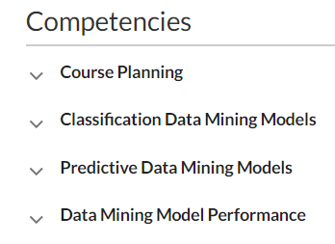

Slide 4
Task 1: Create a data mining report using classification models.
Apply observations to appropriate classes and categories using classification methods (K Nearest Neighbor (KNN) or Naïve Bayes).
Classification is used when the output is categorical. Input = independent variable, output = dependent value.
Evaluate model performance for precision and accuracy.
Analyze, summarize, and discuss the implication of your work.
Write the report of your analysis and do a Panopto video recording of your report.
Submit all necessary documents.
Task 2: Create a data mining report using predictive and data mining models.
Implement predictive data mining models using Decision Trees, Random Forests, or advanced Regression (i.e., lasso or ridge).
Prediction is used when the output is numerical. Prefer to predict a continuous variable with Random Forest Regressor, not Random Forest Classifier.
Evaluate data mining model performance for precision and accuracy.
Analyze, summarize, and discuss the implication of your work.
Write the report of your analysis and do a Panopto video recording of your report.
Submit all necessary documents.
Schedule a time with your CI if you need help. We wish you success and a great learning experience!

Slide 5
Data Set: Churn and Medical
Churn Dataset: The student will analyze the dataset to explore the data, identify trends, and compare key metrics.
Medical Dataset: The student will predict readmission based on other conditions and factors of the patient.
Both techniques KNN and Naïve Bayes can work with either Dataset
KNN predicts the label of any data point by looking at the ‘k’ closest labeled data point, for example, 5, closest labeled data points, and getting them to vote on what the unlabeled point should have. The new data point is then assigned the label of the majority of the ‘k’ closest points.
NB is a classification technique used to reduce the error rate caused by inaccuracy in assumptions. With a 25-churn rate company wants to reduce that rate by predicting at-risk customers. Also, they might want to know from EDA the key contributors/features causing customer churn, the when (trends), and why (KPI).

Slide 6
Learning Resource
This course uses DataCamp as the primary learning resource.
To prepare for the performance assessment, it is recommended that you complete all the DataCamp courses within the Data Mining I track.
This course consists of seven DataCamp courses comprising 29 hours of content:
Supervised Learning with scikit-learn – Python (4 hours)
Machine Learning with Tree-Based Models in Python (5 hours)
Model Validation in Python (4 hours)
Supervised Learning in R: Classification (4 hours)
Supervised Learning in R: Regression (4 hours)
Machine Learning with caret in R (4 hours)
Machine Learning with Tree-Based Models in R (4 hours).

Slide 7
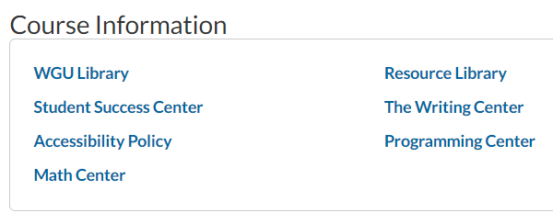

Slide 8
Resource Library
All are hyperlinked on the resource library page.
Cheat Sheets
DataCamp (n.d.) Python for data science cheat sheet. DataCamp.
R Studio (n.d.) RStudio cheatsheets. R Studio.
Books
BRUCE, P. A. (2020). Practical statistics for data scientists. 50+ essential concepts using r and python.
O'Reilly Media, Incorporated. Retrieved from WGU Library.
Larose, C. D., & Larose, D. T. (2019). Data science using Python and R. Chichester, NJ: Wiley Blackwell.
Websites
Information Builders. (n.d.). Welcome to the WebFOCUS release 8 technical library.
Navlani, A. (2018, December 4). Naive Bayes classification using Scikit-learn. DataCamp. https://www.datacamp.com/tutorial/naive-bayes-scikit-learn
STHDA. (n.d.). Factoextra R Package: Easy multivariate data analyses and elegant visualization.
Videos
Jedamski, D. (2019). Applied machine learning: algorithms. LinkedIn Learning.
Kolalapudi, S. (2017). Classification using tree-based models. PluralSight.
Poulson, B. (2020). R essential training part 2: modeling data. LinkedIn Learning.
Pierson, L. (2019). Python for data science essential training part 2. LinkedIn Learning.

Slide 9
Need to study R Syntax?
On the D209 Homepage, click on “GO TO COURSE MATERIAL.”
Under catalog, click on tracks, then Custom Tracks.
You will see an “R Programmer” course. https://app.datacamp.com/learn/career-tracks/r-programmer
Intermediate R courses at https://app.datacamp.com/learn/custom-tracks/custom-r-prep-work
Textbooks
Data Science Using Python and R
A textbook used in D206, provides good supplemental content for this course. Helpful content:
• Chapter 6 Decision Trees & Random Forests
• Chapter 7 Model Evaluation
• Chapter 8 Naive Bayes
Practical Statistics for Data Scientists
Helpful content:
• Chapter 4: Regression and Prediction
• Chapter 5: Classification
• Chapter 6: Statistical Machine Learning

Slide 10
Additional Resources with Data Preparation
Often with data mining/ML models, it is important to do various preprocessing of data
(Techniques: missing data, standardizations, PCA, binding, one-hot encoding, etc.).
Additional resources you might find beneficial in prepping your data for analysis.
Bowne-Anderson, H. (2016). Preprocessing in Data Science (Part 1): Centering, Scaling, and KNN. DataCamp.
Bowne-Anderson, H. (2016). Preprocessing in Data Science (Part 2): Centering, Scaling and Logistic
Regression. DataCamp.
Bowne-Anderson, H. (2016). Preprocessing in Data Science (Part 3): Scaling Synthesized Data. DataCamp.
Brownlee, J. (2016). Get your data ready for machine learning in R with pre-processing. Machine Learning Mastery.
Kumar, D. (2018). Introduction to data preprocessing in machine learning. Towards Data Science.
Shimanto, H. (n.d.). Data preprocessing: Getting started with machine learning.
Analytics India Mag (2019). Data preprocessing with R: Hands-on tutorial. Analytics India Magazine.

Slide 11


Task 1 CLASSIFICATION ANALYSIS

Slide 12
Competencies
Classification Data Mining Models
You will apply observations to appropriate classes and categories using classification models.
Data Mining Model Performance
You will evaluate data mining model performance for precision, and accuracy, and perform a model comparison.

Slide 13
Introduction
The main objective of Task 1 is to create a data mining report that will propose one question relevant to a real-world situation that can be answered using the k-nearest neighbors (k-NN) or Naïve Bayes classification method. In that report, explain how this method analyzes the data set, summarize the findings and assumptions of the analysis, explain the model accuracy scores, and recommend a course of action based on the results.
To achieve that objective:
You will create a data mining report in Microsoft Word.
Select your dataset and data dictionary.
You will use Python or R to analyze your data.
You must visually represent each step of your work and the findings of your data analysis.
All algorithms and visualization used need to be captured either in tables or as screenshots added to the submitted document.
A separate Microsoft Excel (.xls, .xlsx, or .csv) document of the cleaned data should be submitted along with the written aspects of the data mining report. See screenshot or next slice.
Watch for plagiarism: Not more than 30% total match and 10% match to an individual source.
Follow the rubrics to create your submission.
Submit your work as file attachment. File type: docx, .pdf, html, csv.

Slide 14
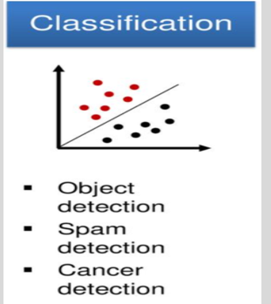
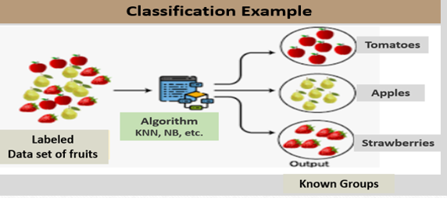
Classification is a machine learning model (algorithm) used to find the location of the item needing classification among measurements of interest, compare this item to items close by, then assign them to a group. It is used for object detection, spam detection, cancer detection, etc. For example, a classification model could be used to identify loan applicants as low, medium, or high credit risks.
Keywords: Locate, Compare, and Assign
Classification is supervised machine learning. For classification, the groups are known or labeled. Data labeling helps tell the difference between two or more objects or data points, e.g., a person, car, a house, a street, etc. See two classification examples below.

Slide 15
REQUIREMENTS
Part I: Research Question
A. 1. Propose one question relevant to a real-world organizational situation that you will answer using one of the following classification methods: k-nearest neighbor (KNN), or Naive Bayes.
A. 2. Define one goal of the data analysis. Ensure that your goal is reasonable within the scope of the scenario and is represented in the available data.
Example Research Question 1:
Is it possible to predict telecom customers who are at churn risk using the k-nearest neighbor's method, so the telecom provider can take the appropriate steps to retain those customers?
Example - Goals
The primary goal of this analysis is to develop a machine learning model using k-nearest neighbors (k-NN) to help the company identify customers who are at churn risk.
Based on EDA identify key contributors/features causing customer churn.
Based on the results and implications of the analysis, recommend a course of action.

Slide 16
Example Research Question 2:
Can the probability of customer churn be predicted from categorial data such as demographic and subscribed services?
Example - Goals
Accurate predictions of the probability that a customer will churn, and how churn relates to the services provided can help drive executive direction related to marketing decisions, business decisions, and customer retention initiatives.
This project aims to be able to forecast in advance that a specific consumer is likely to churn so that appropriate action could be taken to mitigate the risk. In this project, we will clean, evaluate, and create a supervised Machine Learning model.
Example Research Question 3:
What are the major predictor variables in determining or predicting the Churn of the customers from the churn dataset?
Example - Goals
Two goals to achieve in this analysis:
1. Identify major predictors of Churn and determine if it is based on factors like service availability or contract type.
2. To determine if Churn can be predicted based on the trained model.

Slide 17
Part II: Method Justification
B. Explain the reasons for your chosen classification method from part A1 by doing the following:
B.1. Explain how the classification method you chose analyzes the selected data set. Include expected outcomes.
B.2. Summarize one assumption of the chosen classification method.
B.3. List the packages or libraries you have chosen for Python or R and justify how each item on the list supports the analysis.
B.1. Example: How the k-NN classification method analyzes the dataset
The basic idea of k-NN is to predict the label of any data point by looking at the ‘k’ closest labeled data point, for example, 5 closest labeled data points, and getting them to vote on what the unlabeled point should have. The new data point is then assigned the label of the majority of the ‘k’ closest points. k-NN uses distance, and the standard Euclidean distance is the most common and default choice. See the example below:
Note: Data labeling helps tell the difference between two or more objects or data points, e.g., a person, car, a house, a street, etc., by labeling the key features of those objects or data points and looking for similarities between them.

Slide 18
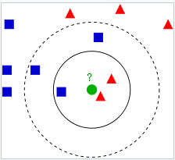
In the diagram, the test sample (green dot) should be classified either to blue squares or to red triangles. If k = 3 (solid line circle), it is assigned to the red triangles because there are 2 triangles and only 1 square inside the inner circle. If k = 5 (dashed line circle), it is assigned to the blue squares (3 squares vs. 2 triangles inside the outer circle).
Expected Outcome
One outcome is to create an algorithm that will have a model accuracy of at least 95% without over or underfitting the model. Another expected outcome is to have test data classified according to their closest neighbors (Harrison, 2019).
B1 Cont’d
Naïve Bayes Example: How the Naïve Bayes classification method analyzes the dataset.
Naïve Bayes classifier classification method is more suitable for large dataset, and all the categorical parameters are independent. A dataset of 10,000 observations and 50 variables is large enough for NB. When the calibration sample sizes increase, Naïve Bayes classifiers will outperform other highly advanced classification methods in terms of classification accuracy. (Rudner, 2016; Vomlel, 2004).
Naïve Bayes classification is based on Bayes Theorem which combines previous knowledge with new information obtained from observed data. Bayes Theorem can be used to identify which class (Churn or Not Churn) is most likely for the provided predictor variables. (Larose, C. D., & Larose, D. T. 2019)

Slide 19
B.2. Summarize one assumption of your chosen classification model.
Assumption of KNN
The k-nearest neighbors (k-NN) classification method assumes that similar things exist in proximity to each other.
If a data point is far away from another group, it’s dissimilar to those data points.
The algorithm depends on this assumption being true enough for the algorithm to be useful.
The algorithm classifies new data points based on how the neighbors are classified (Medium, 2019).
Assumption of Naïve Bayes
Naïve Bayes classification assumes the variables are independent; in other words, a specific feature in a class is unconnected to the occurrence of other elements. (Draper & Smith, 1998).
Naïve Bayes model is assumed to be easy to build and particularly useful for enormous data sets and is known to surpass highly advanced classification methods. (Vomlel J, 2004).

Slide 20

S/N | Python |  | R Language
 | Packages & Libraries | Usage | Packages & Libraries | Usage
4 | os | View Operating system file information. | tidyverse | Essential data science collection
5 | pandas | For importing data into Dataframe and data manipulations. | ggplot2 | Used to generate plots
6 | numpy | Provides array objects for calculations. | dplyr | Essential for data frame manipulation
7 | seaborn | For Visualizations like correlation matrix. | naivebayes | Used for naïve bayes model
8 | matplotlib.pyplot | For Visualizations like ROC Curve. | Psych | Used for graphing variable independence
9 | sklearn.feature_selection import SelectKBest,f_classif | For feature selection. | caret | Predictive models package
10 | sklearn.preprocessing import scale | To scale the features. | e1071 | Required for Confusion Matrix
11 | sklearn.model_selection import train_test_split | For splitting data into train and test sets. | ROCR | Required to create performance curve
12 | sklearn.pipeline import Pipeline | Pipeline is to assemble several steps that can be performed together while setting different parameters. | rpart | Used for building classification and regression trees.
B.3. List the packages or libraries you have chosen for Python or R and justify how each item on the list supports the analysis.
The Python and R packages or libraries listed here apply to both KNN and NB.
See Sample Code

Slide 21
Part III: Data Preparation
C. Perform data preparation for the chosen data set by doing the following:
1. Describe one data preprocessing goal relevant to the classification method from part A1.
2. Identify the initial data set variables that you will use to perform the analysis for the classification question from part A1 and classify each variable as continuous or categorical.
3. Explain each of the steps used to prepare the data for the analysis. Identify the code segment for each step.
4. Provide a copy of the cleaned data set.
C.1. Example: Data preprocessing goal for the k-NN model
Data preprocessing covers a variety of operations used by data scientists to get the data in a form to be ready for analysis and including the following:
For KNN and NB, removing white spaces, imputing missing data, binding, one-hot encoding, etc.
For k-NN, scaling and standardizing are preprocessing methods used to improve model accuracy.
k-NN uses the distance between data points (Euclidean Distance) to label new data points accurately.
k-NN finds a predefined number of training samples closest in the distance to the new point and predicts the label from these. If the feature variables have different scales, then the k-NN will be less accurate.
For NB, feature selection and the removal of data not utilized in the analysis.
Converting character fields to factors.

Slide 22
Scaling is one of the pre-processing methods. Recall that classification uses the method: Locate, Compare, and Assign. The Keywords for KNN are similarity and distance. The k-NN algorithm relies on distance for classification. It assumes that similar things exist in proximity to each other (Medium, 2019).
Scaling is the process of transforming data to fit within a specific scale, like 0-100 or 0-1. You want to scale data when you're using methods based on (distance) measures of how far apart data points are, like support vector machines, SVM or k-nearest neighbors, or KNN.
If the feature/variables have different scales, then the k-NN model will be less accurate in its prediction.
Code example to scale features in Python:
X = scale(X)

Slide 23
Encoding Categorical Data
KNN for instance measures the distances between data points, it requires that the data are numeric (Bruce et al., 2020, p. 239). For binary categorical columns, “Yes” will change to the number 1 and “No” to the number 0.
Standardization of Data
KNN method uses distances to determine predictions, it is important that the predictor variables be standardized to avoid bias toward predictors that are on larger scales (Kuhn and Johnson, 2018, p. 352). You can use the scikit-learn StandardScaler method in Python.
VISUALIZATIONS - During EDA
View the data – for example, histogram
Look for correlation in the data – heatmap
Other Visualizations
D2. KNN - varying number of neighbor's graph
D3. Accuracy score graph
E1. AUC and ROC graph

Slide 24


Eclidean Distance
Based on Pythagoras’ theorem. Calculates the distance between two points p1 and p2.

Slide 25
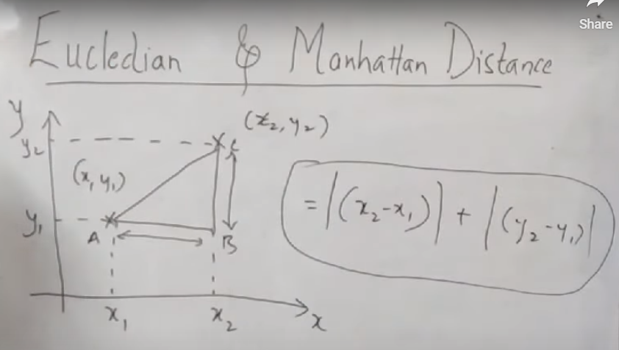
Manhattan Distance
Based on the absolutes meaning, the negative result is turned to positive. Calculates the distance between two points, p1 and p2. You do not calculate the hypotenuse but combine AB and BC

Slide 26
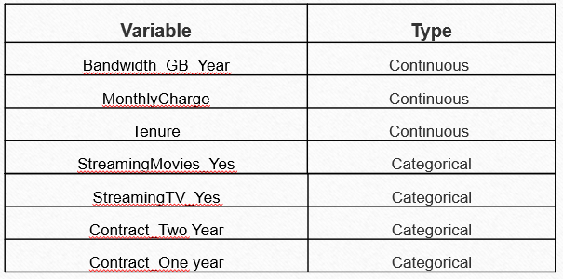
C.2. Identify initial variables used for analysis and classify as continuous or categorical.
On the table are the features/variable to be used for analysis. You can use the SelectKBest in Python to get the output. In R, you can use the str and summary R functions to show the raw data observations and variables. Use the sapply() function in R to output independent variables.
Example Variables on the Teleco Data
S.No | Independent Variable | Data Type | Data Class
1 | Children | Categorical | Qualitative
2 | Marital | Categorical | Qualitative
3 | Gender | Categorical | Qualitative
4 | Contract | Categorical | Qualitative
5 | InternetService | Categorical | Qualitative
6 | Tenure | Continuous | Quantitative
7 | Phone | Categorical | Qualitative
8 | Multiple | Categorical | Qualitative
9 | OnlineSecurity | Categorical | Qualitative
10 | OnlineBackup | Categorical | Qualitative
11 | DeviceProtection | Categorical | Qualitative
12 | TechSupport | Categorical | Qualitative
13 | StreamingTV | Categorical | Qualitative
14 | StreamingMovies | Categorical | Qualitative
15 | PaperlessBilling | Categorical | Qualitative
16 | PaymentMethod | Categorical | Qualitative
17 | Tenure | Categorical | Qualitative
18 | MonthlyCharge | Continuous | Quantitative
19 | Tenure_group | Categorical | Qualitative
Example Variables

Slide 27
C.2. Cont’d
Example Variables on the Medical Data
Continuous variables: | Categorical variables
Population | Area
Children | Marital
Age | Gender
Income | reAdmis
Initial_Days | Initial_Admin
 | Complication_risk

Slide 28
Feature Selection.
Is the process of selecting those features which contribute most to your prediction variable or output of your interest.
SeleckKBest
In Python, SelectKBest from Scikit-learn to select your variables.
SeleckKBest scores the features using a function with f_classif parameter. You can supply K= “all features” to show all features. This helps in selecting features having a significant p-value and building an improvised model. SelectKBest will select the K most explicative features out of the original set, so K should be a value greater than 0 and lower or equal to the total number of features.
In R, str and summary R functions to show the raw data observations and variables.
In R, sapply() function to output independent variables.

Slide 29
Logistic Regression with L1-regularization: L1-regularization introduces sparsity in the dataset and shrinks the values of the coefficients of redundant features to 0.
https://towardsdatascience.com/feature-selection-using-logistic-regression-model-efc949569f58
Lasso Regression can be used to remove redundant features from the dataset.
PCA and Dimensionality Reduction may be too much for this analysis. You will study PCA in D212.

Slide 30
SelectKBest Code in Python
# Assign values to X for all predictor features
# Assign values to y for the dependent variable
X = churn_final_dataset.drop(["Churn_Yes"],1)
y = churn_final_dataset["Churn_Yes"]
print(X.shape)
print(y.shape)
feature_names = X.columns
# Initialize the class and call fit_transform
from sklearn.feature_selection import SelectKBest
skbest = SelectKBest(score_func = f_classif, k='all') # k= features
X_new = skbest.fit_transform(X, y)
X_new.shape
### Finding P-values to select statistically significant features
p_values = pd.DataFrame({'Feature': X.columns, 'p_value':skbest.pvalues_}).sort_values('p_value')
p_values[p_values['p_value'] < .05]
features_to_keep = p_values['Feature'][p_values['p_value'] < .05]
# Print the name of the selected features
Print(features_to_keep)
Feature Selection with the Caret R Package
The caret R package provides tools to report on the relevance and importance of attributes in your data and even select the most important features for you.
Steps:
Remove redundant features from the dataset.
Rank features by their importance.
Select features using the Recursive Feature Elimination method.

Slide 31
Identify highly correlated features in caret R package
# load the library
library(mlbench)
library(caret)
# load the data
data(PimaIndiansDiabetes) // Data set
# calculate correlation matrix
correlationMatrix <- cor(PimaIndiansDiabetes[,1:8])
# summarize the correlation matrix
print(correlationMatrix)
# find attributes that are highly corrected (ideally >0.75)
highlyCorrelated <- findCorrelation(correlationMatrix, cutoff=0.5)
# print indexes of highly correlated attributes
print(highlyCorrelated)
Source: https://machinelearningmastery.com/feature-selection-with-the-caret-r-package/

Slide 32
Rank Features
# prepare training scheme
control <- trainControl(method="repeatedcv", number=10, repeats=3)
# train the model
model <- train(diabetes~., data=PimaIndiansDiabetes, method="lvq", preProcess="scale", trControl=control)
# estimate variable importance
importance <- varImp(model, scale=FALSE)
# summarize importance
print(importance)
# plot importance
plot(importance

Slide 33
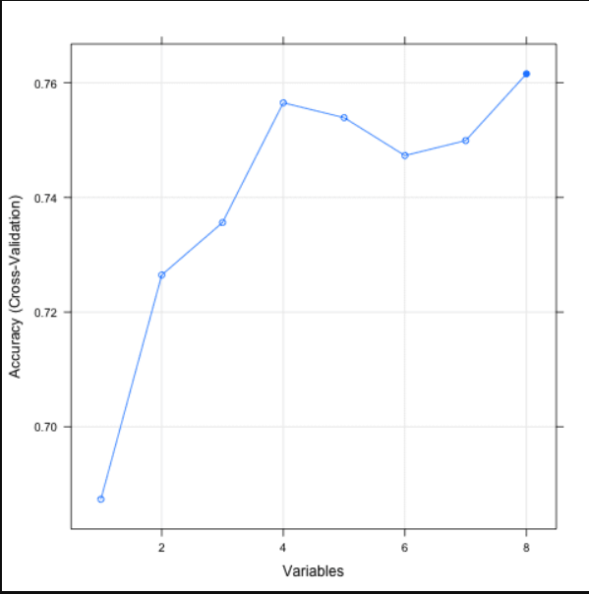
# define the control using a random forest selection function
control <- rfeControl(functions=rfFuncs, method="cv", number=10)
# run the RFE algorithm
results <- rfe(PimaIndiansDiabetes[,1:8], PimaIndiansDiabetes[,9], sizes=c(1:8), rfeControl=control)
# summarize the results
print(results)
# list the chosen features
predictors(results)
# plot the results
plot(results, type=c("g", "o"))

Slide 34
C.3. Explain each of the steps used to prepare the data for analysis. Identify the code segment for each step.
Load the data, perform data cleaning, and perform EDA.
Clean more data to remove irrelevant data for the analysis.
Do the following (the likely things to do) as applicable and include the code:
Load the data into the data frame – Code
View the data – Code
Evaluate the data structures and data types - Code
Remove null values, missing data, outliers - Code
Select variables/features (May use “SelectKBest from scikit-learn) to improve model efficiency - Code.
Rename the columns to give proper naming for the predictors - Code.
Look for correlation in data. Correlated features will carry extra weight on the distance calculation than desired which could negatively impact the model - Code
Convert categorical variables into dummy variables, and this also takes care of datatype change to int for all the object datatypes variables - Code
Scale the features, the k-NN algorithm relies on distance for classification, k-NN accuracy can severely degrade if feature scales are not consistent with their importance - Code

Slide 35
PART IV: ANALYSIS
D. Perform the data analysis and report on the results by doing the following:
D1. Split the data into training and test data sets and provide the file(s).
D2. Describe the analysis technique you used to appropriately analyze the data. Include screenshots of the intermediate calculations you performed.
D3. Provide the code used to perform the classification analysis from part D2.
D1. Split the data into training and test data sets and provide the file(s).
You will write a code to split the data into training and testing sets. The rule of thumb is 80/20. You can use the train_test_split library from sklearn.model_selection to split the data into 80% training and 20% testing data sets. You can use stratify=y, to preserve the same proportions of examples in each class as observed in the original dataset during the split.
The model is trained on the training data set and evaluated on the testing data set. This approach is called hold-out validation. This is to make sure the model has similar accuracy when predicting unseen or new data not seen during training.
Sample split code:
X_train, X_test, y_train, y_test = train_test_split(X, y, train_size = 0.8, test_size=0.2, random_state=15, stratify=y)

Slide 36
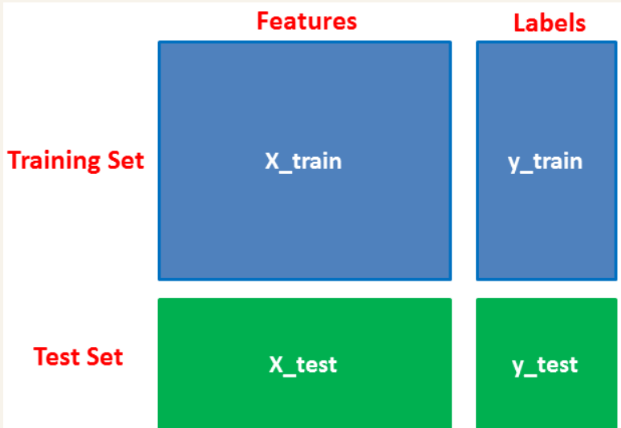
Splitting Data
First, you separate the columns into independent and dependent variables(or features and label). Then you split those variables into train and test sets.
Why x-train, y-train, x-test, y-test?
If you need to work with independent and dependent variables in your analysis, you will first separate the columns into independent and dependent variables. Then you split those variables into train and test sets.
You can label the independent variable x-train and the dependent variable y-train for the training set;
and x-test, y-test for the test set. You will then end up with four files.

Slide 37
Splitting the train and test data into subsets help improve accuracy.
To train your model you use:
X_train as the features and y_train as the ground truth.
To test your model use
X_test as the features and y_test to validate the predicted labels
https://stackoverflow.com/questions/57724175/what-does-this-code-mean-train-test-split-scikitlearn
x_train: The training part of the first sequence (x)
x_test: The test part of the first sequence (x)
y_train: The training part of the second sequence (y)
y_test: The test part of the second sequence (y)
https://realpython.com/train-test-split-python-data/

Slide 38
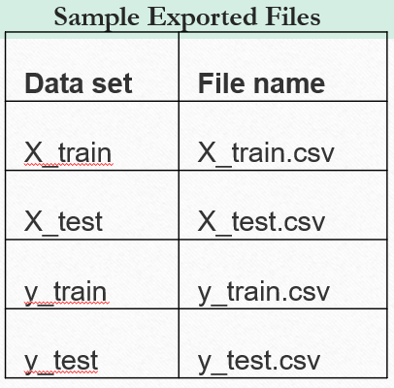
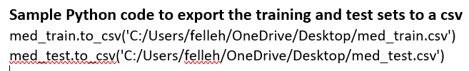
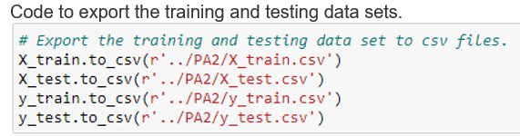
You will write a code to export the training and testing data sets to a CSV file. Can use PA2 file format. PA2 is used by an application called STABCAL (Stability Calculation for Aqueous Systems). Can use the to_ csv( ) to save or export file to csv in python. For working CSV files in python, there is an inbuilt module called csv. See the link below:
https://www.geeksforgeeks.org/working-csv-files-python/

Slide 39
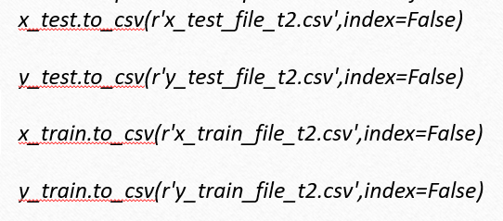
R-Code to export the data
Providing a copy of the cleaned data set
write.csv(med_kNN_norm, file = 'C:/Users/jwing/Desktop/Elleh/WGU/D209/med_kNN_norm.csv’)
Export the training and test files to CSV
write.csv(med_train, file = 'C:/Users/Desktop/Sims/WGU/D209/med_train.csv')
write.csv(med_test, file = 'C:/Users/Desktop/Sims/WGU/D209/med_test.csv')

Slide 40
D2. Describe the analysis technique you used to appropriately analyze the data. Include screenshots of the intermediate calculations you performed.
If you are using classification to predict churn or readmission, you would provide some discussion of what the total number of neighbors should be.
If you are using classification to segment customers into groups, you would need to show how the total number of groups is determined.
If a specific metric (such as, euclidean) is used, what's the rationale for it?
Were there any weights used? If so, why?
What algorithm is being used? Why?
What parameters are being input into the classifier function?
Something along the lines of the scikit learn KNN documentation:
https://scikit-learn.org/stable/modules/generated/sklearn.neighbors.KNeighborsClassifier.html#sklearn.neighbors.KNeighborsClassifier
Some students go all out and compute conditional probabilities and things of the sort and include that in D2, It is acceptable, but not required.

Slide 41
Examples:
KNN technique in this example. k-NN is a non-parametric classification method. The basic idea of k-NN is to predict the label of any data point by looking at the 'k' closest labeled data point, in this example, 5, closest labeled data points, and getting them to vote on what the unlabeled point should have. The new data point is then assigned the label of the majority of the 'k' closest points. k-NN uses distance, and the standard Euclidean distance is the most common choice.
In the diagram, the test sample (green dot) should be classified either as blue squares or red triangles. If k = 3 (solid line circle), it is assigned to the red triangles because there are 2 triangles and only 1 square inside the inner circle. If k = 5 (dashed line circle), it is assigned to the blue squares (3 squares vs. 2 triangles inside the outer circle).
Hints:
You can use the Scikit-learn library of Python to build the k-NN model.
For k-NN ML algorithm to create the model, you might need to convert the categorical variables into dummy variables.

Slide 42
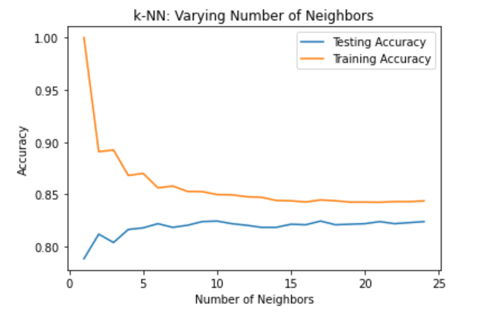
How to determine the optimal value for K
To identify optimal value for n_neighbors ('k), you can use hyperparameter tuning. Hyperparameter tuning tries multiple values for n_neighbors ('k’), fits all of them separately, sees how well they perform, and chooses the best value of 'k' for the model. Hyperparameter tuning is implemented using the class GridSearchCV.
You are welcome to provide a range say from 1 to 30 for the values of 'k' to try. Sample code:
Parameters = {‘knn__n_neighbors’: np.arrange(1,30)}
Remember we split the data into 80/20 and used stratify to preserve the same proportions in each class as observed in the original dataset.
You can use GridSearchCV to perform k-folds cross-validations when called by the fit method.
You can use the best_params to view the best model parameters.
You can use the best_score to provide the best model accuracy score.
You will then obtain the optimal value for n_neighbors, and the accuracy score on the training data set.
Remember to include screen shots of the calculation.
You can plot a model complexity curve to show the visualization of the model's training and testing scores.
See sample model complexity curve showing various values of K and how the fitting happens on train and test data

Slide 43
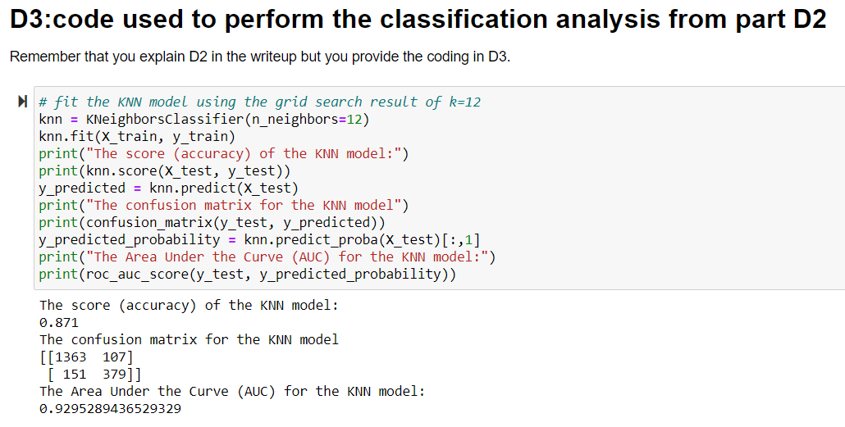
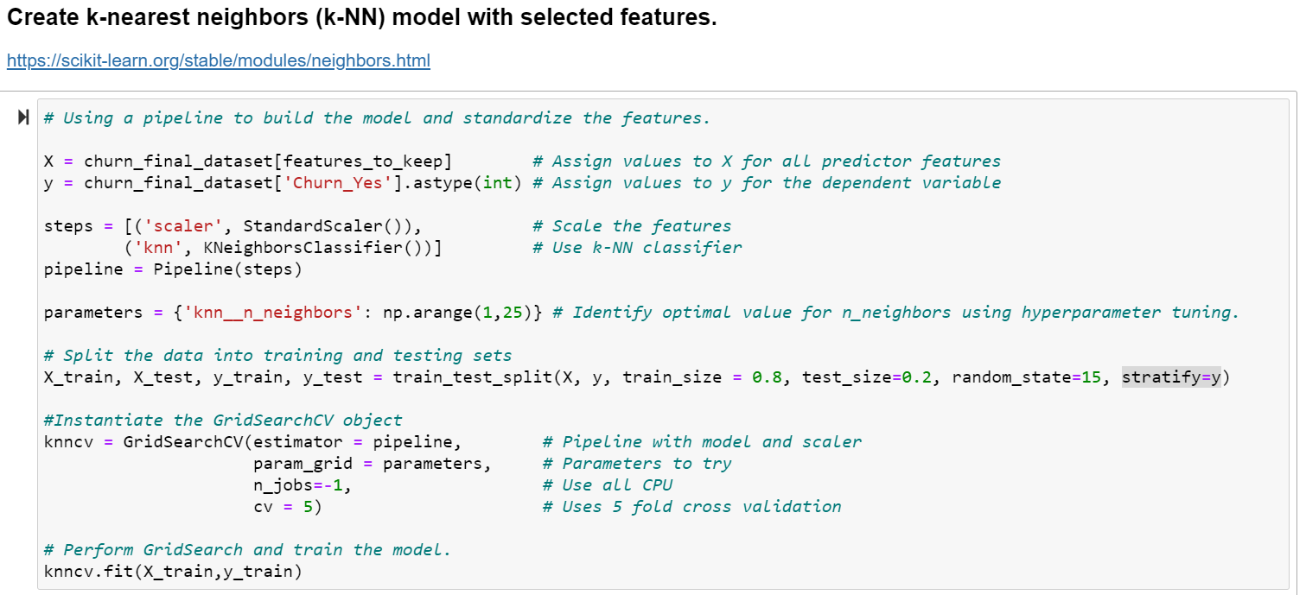
D3. Provide the code used to perform the classification analysis from part D2.
OR
Here, the examiner is looking for the code. Like, literally, classifier calls, training, and predictions of the test data.
Code to convert categorical variables into dummy variables.
Code to create kNN model:

Slide 44
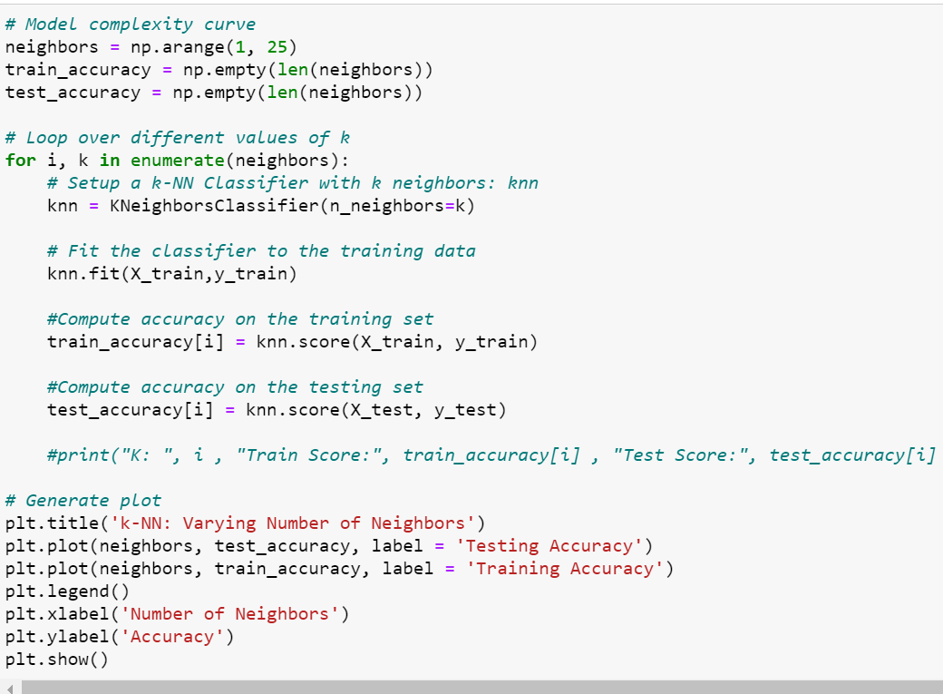
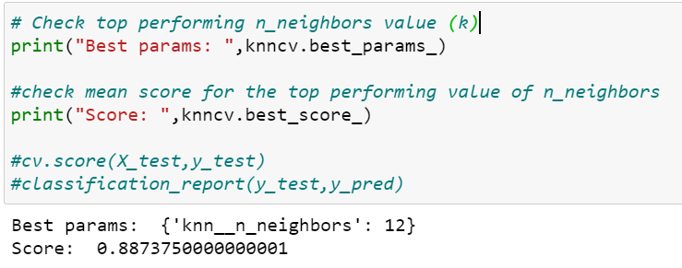
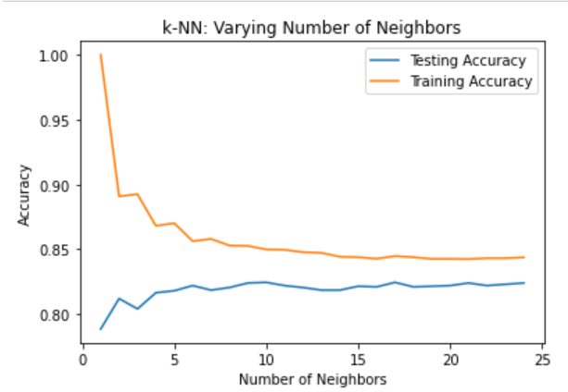
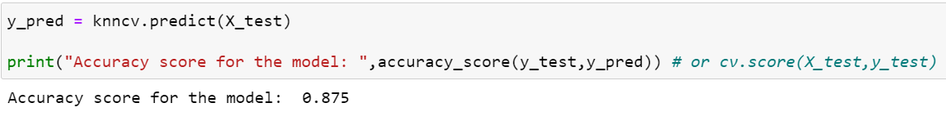
Example code to print the best k value identified by GridSearchCV() function along with the training accuracy score.
Code for model complexity curve (Datacamp, n.d).
Output:
Code to perform predictions on the test data and print test accuracy score.

Slide 45
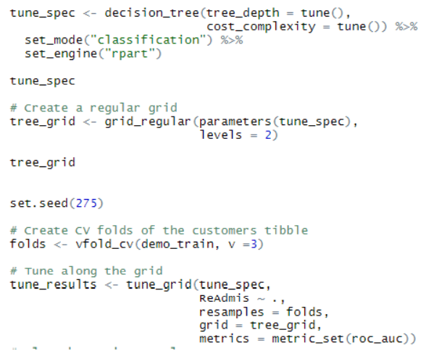
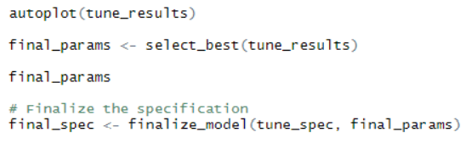
Hyperparameter Tuning in R
Selecting the best parameters R

Slide 46
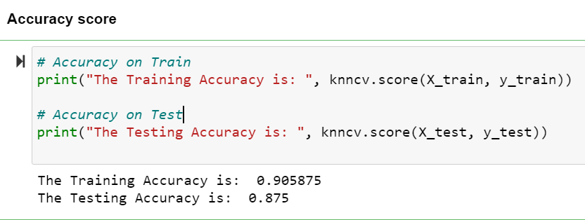
PART V: DATA SUMMARY AND IMPLICATIONS
E. Summarize your data analysis by doing the following:
E.1. Explain the accuracy and the area under the curve (AUC) of your classification model.
E.2. Discuss the results and implications of your classification analysis.
E.3. Discuss one limitation of your data analysis.
E.4. Recommend a course of action for the real-world organizational situation from part A1 based on your results and implications discussed in part E2.
Sample code:
E.1. Explain the accuracy and the area under the curve (AUC) of your classification model.
Accuracy – Classification accuracy is the number of correct predictions made as a ratio of all the predictions (Brownlee, 2018).

Slide 47
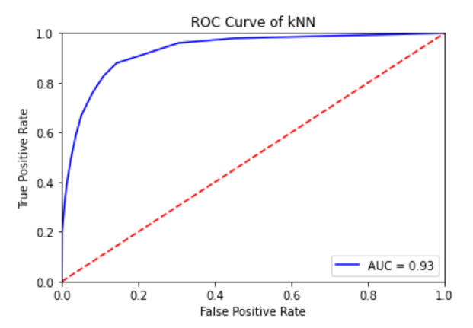
Scikit-learn provides a method classification_report() to generate various scores of accuracy for a model.
Accuracy score - Is correct classifications over total samples.
Precision score – Percentage of correct classifications per label (1). The number of true positives divided by the number of true and false positives.
Recall score –The number of true positives divided by the number of true positives plus the number of false negatives.
F1_score - Average of Precision and Recall scores. The F1-score for my model is 73.95%.
AUC – The AUC represents a model’s ability to discriminate between positive and negative classes. An area of 1.0 represents a model that made all predictions perfectly. An area of 0.5 represents a model as good as random.
In other words,
AUC is the measure of a classifier's ability to distinguish between classes and is used as a summary of the ROC curve. AUC measures the whole 2-dimensional Area under the ROC as an entire curve from (0,0) to (1,1). AUC ranges in value from 0 to 1. (Rossant C.,2013). A model AUC of 0.0 is with predictions 100% wrong; ). A model AUC of 1.0 is with predictions 100% correct.
ROC - The Receiver Operator Characteristic (ROC) curve is an evaluation metric for binary classification problems. It is a probability graph that plots the TPR (true positive rate) against FPR (false positive rate) at various threshold values and essentially separates the 'signal' from the 'noise’.

Slide 48
AUC_ROC
You can use "sklearn.metrics.roc_auc_score" to compute the area under the Receiver Operating Characteristic Curve (ROC AUC) from prediction scores (Analytics Vidya, 2020).
ROC Curve Code in R:
cfm <- table(predchurndata_Class, churn_dataTest$Churn)
cfm
The accuracy of the model is calculated by dividing the sum of the True Positive and True Negative by the sum of the True Positive, False Positive, True Negative, and the False Negative.
Code in R:
ModelAccuracy <- (cfm[1,1] + cfm[2,2]) / (cfm[1,1] + cfm[1,2] + cfm[2,2] + cf m[2,1])
AccuracyPercent <- ModelAccuracy * 100
AccuracyPercent
The sensitivity of the model is calculated by dividing the True Positive by the sum of the True Positive and False Negative.
ModelSensitivity <- (cfm[1,1]) / (cfm[1,1] + cfm[2,1])
SensitivityPercent <- ModelSensitivity * 100
SensitivityPercent.

Slide 49
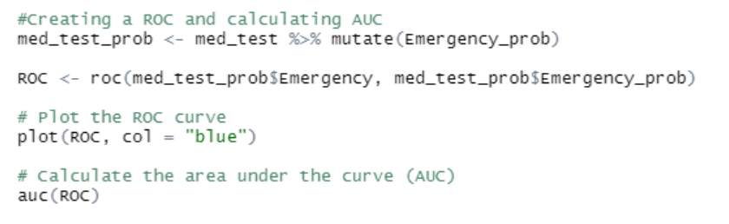
The specificity of the model is calculated by dividing the True Negative by the sum of the True Negative and the False Positive.
ModelSpecificity <- (cfm[2,2]) / (cfm[2,2] + cfm[1,2])
SpecificityPercent <- ModelSpecificity * 100
SpecificityPercent.
In the example below, I was using KNN to predict initial admission into the emergency room based on pre-existing conditions

Slide 50
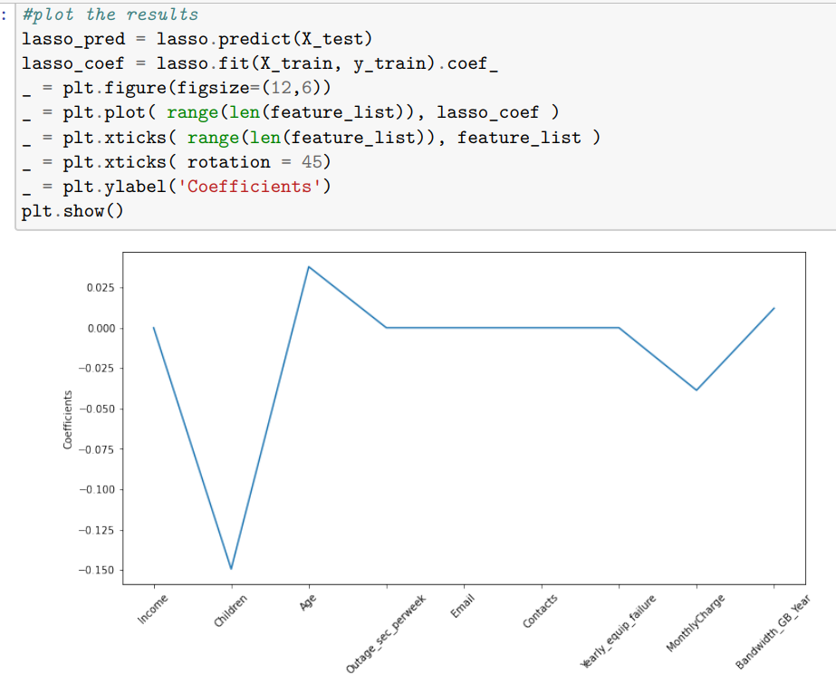
E.2. Discuss the results and implications of your classification analysis.
The k-nearest neighbors (k-NN) algorithm is a simple, supervised machine learning algorithm that can be used to solve classification and regression problems.
Talk about your model accuracy score, feature used (e.g., SelectKBest approach of feature selection, hyperparameter tuning, ) , and implications (could model improve further with hyperparameter tuning, by using more labeled data to train the model, etc.)
If you doing regression (lasso or ridge), you can talk about the significant level of each predictor or the coefficients of the predictors. Example below:

Slide 51
E.2. Discuss the results and implications of your classification analysis.
The k-nearest neighbors (k-NN) algorithm is a simple, supervised machine learning algorithm that can be used to solve classification and regression problems.
Talk about your model accuracy score, feature used (e.g., SelectKBest approach of feature selection, hyperparameter tuning, ) , and implications (could model improve further with hyperparameter tuning, by using more labeled data to train the model, etc.)
E.3. Discuss one limitation of your data analysis.
Talk about data balance or data size. Model could perform poorly on imbalanced data. Also, data should be equally distributed for improved model performance. For instance, the data available for this analysis had 10,000 observations, of which 7350 observations for non-churn customers and 2650 observations for churn customers. This might result in getting the less common class “churn” wrongly classified.
E.4. Recommend a course of action for the real-world organizational situation from part A1 based on your results and implications discussed in part E2.
Based on this analysis report and the model's accuracy score, the company can use this k-NN model to predict customers who are churn risk.
The model could be further improved by performing hyperparameter tuning on additional parameters and by using more labeled data to train the model.
Based EDA, customers who are on contract (one year and two years) had less churn. In contrast, customers on monthly-month contracts have higher churn chances (close to 40% churn).

Slide 52
PART VI: Demonstration
F. Provide a Panopto video recording that includes a demonstration of the functionality of the code used for the analysis and a summary of the programming environment. Note: The audiovisual recording should feature you visibly presenting the material (i.e., not in voiceover or embedded video) and should simultaneously capture both you and your multimedia presentation. See Requirement page for details on how access, use, and submit your Panopto video recording.
G. Record the web sources used to acquire data or segments of third-party code to support the analysis. Ensure the web sources are reliable.
H. Acknowledge sources, using in-text citations and references, for content that is quoted, paraphrased, or summarized.
If the evaluator commented that the reference list citations are presented with limited bibliographical detail. See what that means on the next slide:

Slide 53
The lack of bibliographical details means that the reference (s) even though listed did not have the minimal set of elements needed to identify that source. For a Journal article, you might need: name of the author(s), year of publication, title, journal name, volume, issue number, pagination, URL, etc.
Journal Example:
Debbie, T., Timothy, K. J., & Mark, F. N. (2007). IT project risks: The project management professional perspective. The Journal of Computer Information Systems, 1-5.
Web Example:
Brownlee, J. (2018). Metrics to evaluate machine learning algorithms in Python. Retrieved 01/03/2022 from https://machinelearningmastery.com/metrics-evaluate-machine-learning-algorithms-python
I. Demonstrate professional communication in the content and presentation of your submission.

Slide 54
FREQUENTLY ASKED QUESTIONS
Q1. I have a previous DataCamp Account, when I tried to sign in it redirected me to my previous account and asked me to pay money whey trying to sign in. Here is what you do:
You will need to delete an existing account: In DataCamp's profile settings. Under the list of "why are you deleting" checked 'my organization has DataCamp Business SSO' or close to that wording. Then when you click on "go to course materials" on D209 main page, your new account and full access to DataCamp pop up, including details on D209 etc." If it does not seem to work the first time, do it again. Then go back and click on "GO TO COURSE MATERIALS" on D209 main page, you will have full access to your WGU/ DataCamp.
You can click the link to the DataCamp site by using the WGU SSO with your student email and login.

Slide 55
Q2. I am working on both Task 1 and 2 simultaneously. Can I pick the same Problem for both and use different algorithms? The answer is Yes.
Q3. How do I get access to the course folder?
Answer: Send an email to the Panopto Assessment Team and request that they give you access to the Course folder, and they will do within 48 hours.
Q4. I am not exactly sure which DataCamp courses I am supposed to do. Is there any guidance on that?
Answer: After clicking on the Course Material button, the navigation takes you to Data Camp and the lessons for the custom track D209, Data Mining 1. There are seven course video courses in the overall courses which contain smaller video chapters with a total runtime of 29 hours. You need to review all the 7 courses.
Q5. I cannot find anything in the course materials on how to implement xyz on the final assessment?
Answer: Throughout the course you will find a variety of interactive elements that are designed to challenge and deepen your comprehension of the topics presented. It is important to note that these elements are not meant to reveal any characteristics about the format or design of the final assessment. Instead, they are designed specifically to help you learn, and are offered as tools for you to use to your advantage as you work through the course.

Slide 56
Q6. I have seen conflicting information about the features that can be used to train the KNN model. Datacamp stated that only continuous data can be used; while some other reading materials such as the 'Practical Statistics' said that categorical data can be used if it is re-expressed as numeric integers. I guess I am confused on what would work to build a KNN model for PA1. Any guidance would be greatly appreciated.
Answer: Classification is used when the output is categorical. Both sources are saying pretty much the same thing. Continuous data can be used. Continuous data are numeric variables (numeric or date/time) that have an infinite number of values between any two values.
When you re-expressed categorical data as numeric integers, they have become numerical as well.
One-hot encoding. You can use One-hot encoding to convert categorical variables to numerical in an interpretable format to prepare it for an algorithm and get a better prediction. With one-hot, you convert each categorical value into a new categorical column and assign a binary value of 1 or 0 to those columns. Each integer value is represented as a binary vector.
Dummy Variables: You can also convert your categorical data into dummy variables.

Slide 57
Q7. I have been trying to find a good way to convert 'Yes' / 'No' to a value like 1 or 0. I have found several ways to convert some strings but not Yes/No. It looks like dummy variables sort of works but based on what I am seeing it creates extra columns, I just want one column. Does anyone have a good reference?
Answer: Helpful links:
https://stackoverflow.com/questions/51672709/converting-no-and-yes-into-0-and-1-in-pandas-dataframe
https://stackoverflow.com/questions/37707060/converting-data-frame-column-from-character-to-numeric/37707117
Converting categorical variables to dummy variables works if done correctly. You can also use One-hot encoding to convert categorical variables to numerical. With one-hot encoding, you convert each categorical value into a new categorical column and assign a binary value of 1 or 0 to those columns.

Slide 58
Q8. What are the classification metrics to evaluate Machine Learning Algorithms in Python? They are:
Classification Accuracy.
Log Loss.
Area Under ROC Curve.
Confusion Matrix.
Classification Report.
Q9. What is AUC, ROC, Accuracy Score? What other accuracy tests can I perform?
AUC and ROC are performance metric for binary classification problems.
The AUC represents a model’s ability to discriminate between positive and negative classes. An area of 1.0 represents a model that made all predictions perfectly. An area of 0.5 represents a model as good as random.
A ROC Curve is a plot of the true positive rate (TPR) and the false positive rate (FTP) for a given set of probability predictions at different thresholds used to map the probabilities to class labels. The area under the curve is then the approximate integral under the ROC Curve.
Brownlee, J. (2018). Metrics to evaluate machine learning algorithms in Python. Retrieved 10/20/2021 from
https://machinelearningmastery.com/metrics-evaluate-machine-learning-algorithms-python
Brownlee, J. (2018). How to Use ROC Curves and Precision-Recall Curves for Classification in Python. Retrieved from
https://machinelearningmastery.com/roc-curves-and-precision-recall-curves-for- classification-in-python/

Slide 59
Other accuracy tests
Accuracy score - Is correct classifications over total samples.
Precision score – Percentage of correct classifications per label. The number of true positives divided by the number of true and false positives.
Recall score –The number of true positives divided by the number of true positives plus the number of false negatives.
F1_score - Average of Precision and Recall scores.
Q10. How do I convert (encoding) categorical variables to continuous(numerical)?
Encoding: Converting binary (yes/no) variables to numerical variables?
Convert to binary dummy variables - A common approach that can be used in a predictive model.
One hot encoder - converts each categorical value into a new categorical column and assigns a binary value of 1 or 0 to those columns. Each integer value is represented as a binary vector.
https://www.oreilly.com/library/view/practical-statistics-for/9781491952955/ch04.html
https://stackoverflow.com/questions/51672709/converting-no-and-yes-into-0-and-1-in-pandas-dataframe
https://stackoverflow.com/questions/37707060/converting-data-frame-column-from-character-to-numeric/37707117

Slide 60
Q11. After the split, which dataset will I use to fit the model?
You will fit the model on the training data set.
Evaluate its scores on the testing dataset.
Q12. In KNN, what is a good value for k? The value of k is determined by taking the square root of the number of observations. Python code = np.sqrt(150), where 150 is the no. of observations. K will be 12.247448…
In KNN, a small value of k may indicate a greater impact of noise on the result and a large value of k may make it computationally expensive.
https://www.youtube.com/watch?v=rqkwWau9H-4
https://towardsdatascience.com/how-to-find-the-optimal-value-of-k-in-knn-35d936e554eb

Slide 61
Q13. What are good techniques for selecting variables for KNN and/or Naive Bayes?
PCA is a great tool for selecting variables in magnitude.
SelectKBest in Python to select your variables. In R, you can use the str and summary R functions to show the raw data observations and variables. A customer that disconnected last month, maybe target-dependent variables. You may use the sapply() function in R to output independent variables.
Lasso Regression (Logistic Regression with L1-regularization) can be used to remove redundant features from the dataset. L1-regularization introduces sparsity in the dataset and shrinks the values of the coefficients of redundant features to 0.

Slide 62
What resources do I need to pass the course in R?
In my video, some R code examples are on the PPT itself such as AUC and ROC codes. Also, there is an abundance of resources in R in the Course. They cover what the students need to pass the course. Please see below:
Supervised Learning in R: Classification.
Supervised Learning in R: Regression.
Machine Learning with caret in R.
Tree-Based Modules in R.
Under the resource library, there are (all hyperlinked):
Cheat sheet: R Studio (n.d.) RStudio cheatsheets. R Studio.
Book: Larose, C. D., & Larose, D. T. (2019). Data science using Python and R. Chichester, NJ: Wiley Blackwell.
Video: Poulson, B. (2020). R essential training part 2: modeling data. LinkedIn Learning.
If you need a refresher in R, you can follow the links below:
Basic R Course: https://app.datacamp.com/learn/career-tracks/r-programmer
Intermediate R course: https://app.datacamp.com/learn/custom-tracks/custom-r-prep-work

Slide 63
REFRENCE SECTION
TASK 1

Slide 64
Python - KNN
Brownlee, J. (2018, May 25). Metrics to evaluate machine learning algorithms in python. https://machinelearningmastery.com/metrics-evaluate-machine-learning-algorithms-python/
Datacamp. (n.d). Supervised Learning with scikit-learn. https://learn.datacamp.com/courses/supervised- learning-with-scikit-learn
Medium. (2018, Sep 26). Building a k-Nearest-Neighbors (k-NN) Model with Scikit-learn. https://towardsdatascience.com/building-a-k-nearest-neighbors-k-nn-model-with-scikit-learn- 51209555453a
Medium. (2019, Feb 13). Machine Learning Basics with the K-Nearest Neighbors Algorithm. https://towardsdatascience.com/machine-learning-basics-with-the-k-nearest-neighbors-algorithm- 6a6e71d01761
Scikit-learn. (2020). Nearest Neighbors. https://scikit-learn.org/stable/modules/neighbors.html
Simplilearn. (2018, Jun 6). KNN algorithm using python [Video]. YouTube. https://www.youtube.com/watch?v=4HKqjENq9OU
Stack Overflow. (2018, Oct 20). Implementing roc curves for k-nn machine learning algorithm using python and scikit learn. https://stackoverflow.com/questions/52910061/implementing-roc-curves-for-k-nn-machine- learning-algorithm-using-python-and-sci

Slide 65
Python - KNN
Harrison, O. (2019, July 14). Machine learning basics with the K-nearest neighbors algorithm. Medium. Retrieved October 24, 2021, from https://towardsdatascience.com/machine-learning-basics-with-the-k-nearest-neighbors-algorithm-6a6e71d01761.
M. C., By, -, Marina Chatterjeehttps://www.greatlearning. (2021, April 19). The introduction of Knn algorithm: What is KNN algorithm? GreatLearning Blog: Free Resources what Matters to shape your Career! Retrieved November 25, 2021, from https://www.mygreatlearning.com/blog/knn-algorithm-introduction/.
K Nearest Neighbor Algorithm In Python | Develop k-Nearest Neighbors in Python From Scratch. https://www.youtube.com/watch?v=rqkwWau9H-4

Slide 66
Python - Naïve Bayes
Naive Bayes Classifier using Python's Scikit-learn package. https://www.datacamp.com/community/tutorials/naive-bayes-scikit-learn.
https://www.analyticsvidhya.com/blog/2017/09/naive-bayes-explained/.
https://www.simplilearn.com/tutorials/machine-learning-tutorial/naive-bayes-classifier.

Slide 67
R - KNN
Kuhn, M. (Nov 10, 2008). Building Predictive Models in R Using the caret Package
https://www.jstatsoft.org/article/view/v028i05
ROC and AUC in R. https://www.youtube.com/watch?v=ypO1DPEKYFo.

Slide 68
R - Naïve Bayes
(2021, April 9). Naive Bayes Classification in R. R-Bloggers. https://www.r-bloggers.com/2021/04/naive-bayes-classification-in-r/
S. (2021, June 25). Understanding Naive Bayes Classifier. Simplilearn.Com. https://www.simplilearn.com/tutorials/machine-learning-tutorial/naive-bayes-classifier
https://www.r-bloggers.com/2021/04/naive-bayes-classification-in-r/

Slide 69
AttributeError Getting Attribute Error in my code, what does it mean?
AttributeError can be defined as an error that is raised when an attribute reference or assignment fails. To solve these errors, first check that the attribute you are calling exists. Then, make sure the attribute is related to the object or data type with which you are working.
For example, if we take a variable x we are assigned a value of 10. In this process suppose we want to append another value to that variable. It’s not possible. Because the variable is an integer type it does not support the append method. Link: AttributeError
Example 1: An integer value does not support the append() method.
TwoPython programs to demonstrate AttributeError
X = 10
X.append(6)
## AttributeError: 'int' object has no attribute 'append'
append() method adds an additional element to the end of the variable X, but the value of X is an integer that does not support the append() method.

Slide 70
Example 2: Python is case-sensitive, variation in spelling causes AttributeError.
string = "The famous website is { }".fst("geeksforgeeks")
print(string)
## AttributeError: 'str' object has no attribute 'fst’
https://www.geeksforgeeks.org/python-attributeerror/
https://careerkarma.com/blog/python-attributeerror/#:~:text=Attribute%20errors%20in%20Python%20are,with%20which%20you%20are%20working.
data = vectorizer.fit_transform(mealarray.ravel())
CountVectorizer is taking lists (with string contents) as an argument rather than array. That solved my problem.
https://stackoverflow.com/questions/26367075/countvectorizer-attributeerror-numpy-ndarray-object-has-no-attribute-lower

Slide 71
AttributeError: 'Flags' object has no attribute 'c_contiguous’
This error might be a bug on scikit-learn 1.3.0 and the fix is awaiting release. You can downgraded scikit-learn to 1.2.2 and it may be the solution for you.
C-contiguous, or simply contiguous arrays, refer to data that is stored row-wise, i.e. the indexing of data as stored in memory starts from the highest dimension.
Fortran-contiguous arrays refer to data that is stored column-wise, i.e. the indexing of data as stored in memory starts from the lowest dimension.

Slide 72
Code Errors and Fixes - Python
TypeError: expected string or bytes-like object
The Python TypeError : expected string or bytes-like object" occurs when we pass an argument of a different type to a method that expects a string argument, e.g. re. sub() . To solve the error, make sure to pass a string argument to the method.
When fitting the model, you get ’Cast string to float is not supported’
SIMPLE TO FIX, just use the following code to change the data type of your Target Variable to int,
df[“x_train"] = df[“y_train"].astype(str).astype(int)
df[“x_test"] = df[“y_tets"].astype(str).astype(int)

Slide 73
Task 2: PREDICTIVE ANALYSIS Decision Trees, Random Forests, advanced Regression (lasso or ridge)

Slide 74
Competencies
Predictive Data Mining Models
The learner implements prediction data mining models to find hard-to-spot relationships among variables.
Data Mining Model Performance
The learner evaluates data mining model performance for precision, accuracy, and model comparison.

Slide 75
Introduction
In this task, you will create a data mining report. In doing so, you must select one of the data dictionary and data set files to use for your report from the following link: Data Sets and Associated Data Dictionaries.
You will use Python or R to analyze the given data and create a data mining report in a word processor (e.g., Microsoft Word). Throughout the submission, you must visually represent each step of your work and the findings of your data analysis.
To achieve that objective:
Implement predictive data mining models using Decision Trees, Random Forests, or advanced Regression (i.e., lasso or ridge).
Evaluate data mining model performance for precision and accuracy.
Analyze, summarize, and discuss the implication of your work.
Write the report of your analysis and do a Panopto video recording of your report.
Submit all necessary documents.

Slide 76
Python or R Environments
Python Environments in Anaconda. Please see my video on how to install and update Anaconda in the Announcement and Course Tips.
Jupyter Notebooks are based on JSON files. The Jupyter Notebook is the original web application for creating and sharing computational documents. It offers a simple, streamlined, document-centric experience. My preference for this assignment.
Jupyter Lab is the latest web-based interactive development environment for notebooks, code, and data. Its flexible interface allows users to configure and arrange workflows in data science.
https://jupyter.org/

Slide 77
Python or R Environments
Select among R Script, R Notebook, and R Markdown
RStudio is a convenient interface or platform for programming in R.
R Script in my opinion is the actual programming language. Because it is a text file containing the same commands that you would enter on the command line of R. R script can be compiled into a report that includes commentary, source code, and script output formats including HTML, PDF, MS Word, and Markdown.
R Markdown is a specific type of file format designed to produce documents that include both code and text. This is my preference for this assignment so you can submit both your report and the code in one rich document.
R Notebook is a way to work with R Markdown files. Not designed for all types of work e.g., building a shiny app.

Slide 78
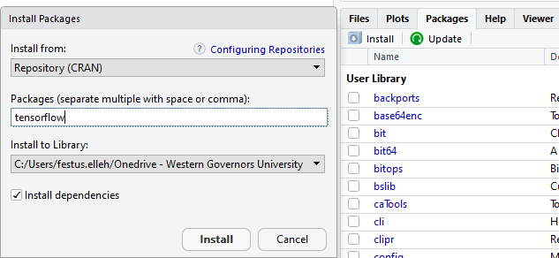
INSTALLING PACKAGES IN R
Click on ‘Install’ Under the “Files, Plots, Packages, Help, Viewer” pane.
Type in ‘TensorFlow’ in the “Packages” textbox as shown above.
Click “Install”
R will install TensorFlow.
Then, in the Source code pane, call the TensorFlow package by typing
library(tensorflow) and run.
Done!

Slide 79
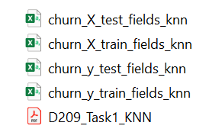
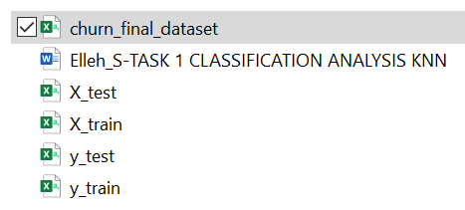
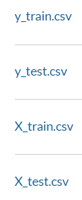
Cleaned Files

Slide 80
VISUALIZATIONS
Task 2 - Visualizations
During EDA
View the data – for example, histogram
Other Visualizations
C3 Correlation in data – Heatmap
D2 Graph of your model
E1 MSE, RMSE, R2 – table or graph

Slide 81
REQUIREMENTS
Part I: Research Question
A. 1. Propose one question relevant to a real-world organizational situation that you will answer using one of the following prediction methods: decision trees, random forests, advanced regression (i.e., lasso or ridge).
A. 2. Define one goal of the data analysis. Ensure that your goal is reasonable within the scope of the scenario and is represented in the available data.
Example Research Question:
Is it possible to predict the tenure of a customer and identify key contributors using the random forests methods based on the available data?
Example - Goals
The primary goal is to develop a random forests machine learning model to help the company predict its customers' tenure.
Identify key contributors/features causing customer churn EDA.
Recommend a course of action based on the results and implications of the analysis.

Slide 82
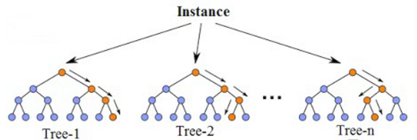
Part II: Method Justification
B. Explain the reasons for your chosen prediction method (DT, RF, or RG) from part A1 by doing the following.
B1. Explain how the prediction method you chose analyzes the selected data set. Include expected outcomes.
Random forests (RF)
Random forests are an ensemble learning method for classification and regression. It constructs multiple decision trees at the training time and outputs the mean of the predictions for regression. Each of the trees makes its own individual prediction. These predictions are then averaged to produce a single result.
Rationale: The averaging makes a Random Forest better than a single decision tree, improving its accuracy and reducing overfitting. A prediction from the Random Forest Regressor is an average of the trees' predictions in the forest. You can use the Scikit-learn library of Python to build the random forest model and the GridSearchCV() class to perform hyperparameter tuning.

Slide 83
B1 Cont’d
Decision tree
A decision tree is a machine learning algorithm that can handle both categorical and numerical data, requires less computation time, training time, not sensitive to the outlier, and is nonparametric. Thus, the decision tree will be a good fit for my dataset.
"According to Sehra (2020), a decision tree breaks down the data set into smaller subsets of instances with similar values (homogenous) like a flowchart diagram. Each subset has a leaf node and decision node. Each node represents features, and each branch represents a decision rule (test outcome).
There are two or three branches or sub-tree on a decision node. A terminal leaf node is the end of the algorithm, representing a final decision(outcome). The topmost decision node is called the root node, meaning the best predictor.

Slide 84
B1 Cont’d: Using Lasso Regression example. Lasso is a regression analysis method that performs both variable selection and regularization in order to enhance the prediction accuracy and interpretability of the resulting statistical model. The word “LASSO” stands for Least Absolute Shrinkage and Selection Operator. Lasso is meant to take a series of features and identify those most likely to have an impact on the prediction. If there is little to no impact, the feature is ignored. The Lasso regression is chosen because it will automatically remove features that do not have much impact on the model. It works well when there is a large set of features to choose from, but not all of them will influence the prediction. All the features are continuous numerical value.
B1 Cont’d: Using Ridge Regression example. Ridge regression is a method of estimating the coefficients of multiple-regression models in scenarios where linearly independent variables are highly correlated. Ridge regression is a model tuning method that is used to analyze any data that suffers from multicollinearity. This method performs L2 regularization. When the issue of multicollinearity occurs, least-squares are unbiased, and variances are large, this results in predicted values being far away from the actual values.
https://www.mygreatlearning.com/blog/what-is-ridge-regression/

Slide 85
B2. Summarize one assumption of the chosen prediction method.
Random Forest Example:
The random forest uses bootstrap aggregation, and it assumes that sampling is representative, which is also an assumption of the decision tree on which the random forest is built. The tree-based model depends heavily on the training dataset used to build the model. For example, if one class consist of two components and in our dataset one component is represented by 100 samples, and another component is represented by 1 sample - probably most individual decision trees will see only the first component, and Random Forest will misclassify the second one (StackExchange, n.d).
Decision Tree Example:
According to Navlani (2018), one assumption of the decision tree algorithm is that it is a non-parametric. It doesn't make distribution assumptions on the data. Thus, decisions can deal with non-linear data, skewed data, multi-modal data, and categorical, ordinal, and non-ordinal data efficiently. This characteristic makes the model easier to understand, interpret, and visualize.
Ridge Regression Example
The assumptions of ridge regression are the same as that of linear regression: linearity, constant variance, and independence. However, as ridge regression does not provide confidence limits, the distribution of errors to be normal need not be assumed.

Slide 86
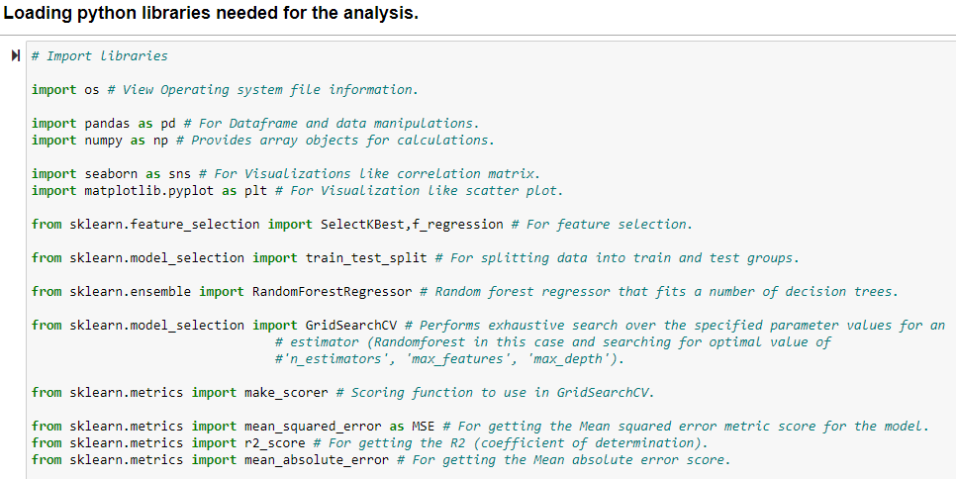
B3: The list of libraries and their usages for this analysis are shown on the table on the next page.

Slide 87
Library name | Usage
os | View Operating system file information.
pandas | For importing data into Dataframe and data manipulations.
numpy | It provides array objects for calculations.
seaborn | For Visualizations like correlation matrix.
matplotlib.pyplot | For Visualization like scatter plot.
sklearn.feature_selection import SelectKBest,f_classif | For feature selection.
sklearn.model_selection import train_test_split | For splitting data into train and test sets.
sklearn.ensemble import RandomForestRegressor | Random forest regressor that fits a number of decision trees.
sklearn.model_selection import GridSearchCV | Performs exhaustive search over the specified parameter values for an estimator (Randomforest in this case and searching for the optimal value of 'n_estimators', 'max_features', 'max_depth').
sklearn.metrics import accuracy_score | It provides an accuracy score for the model.
sklearn.metrics import make_scorer | Scoring function to use in GridSearchCV.
sklearn.metrics import mean_squared_error as MSE | For getting the Mean squared error metric score for the model.
sklearn.metrics import r2_score | For getting the R2 (coefficient of determination).
sklearn.metrics import mean_absolute_error | For getting the Mean absolute error score.

Slide 88
B3 Cont’d. R packages or libraries Example.
Package/Library Name | Usage
dplyr | For improving and simplifying the variable names
caret | For classification and regression training functions. Helps find and remove highly correlated variables. Will allow the use of the train () function. Also used for viewing the confusion matrix
ggplot2 | For creating graphical representations
E1071 | For supporting the Decision Trees and random forest models.
Ranger | For implementing decision tree and random forests models
RocR | For display and analyzing the ROC curves and AUC values.
varImp | To plot importance of features in the model
RandomForest | For creating models
Rpart | For running the DT algorithm. For train classification tree and for plotting the Tree and building Decision Tree model
base | For predicting and fitting the DT model
Party | For creating and visualizing decision trees.
DAAG | For Data Analysis and Graphics Data and Functions
pROC | For displaying and analyzing ROC Curves
tree | For filtering missing data from the model frame.

Slide 89
Part III: Data Preparation
C. Perform data preparation for the chosen data set by doing the following:
C1. Describe one data preprocessing goal relevant to the prediction method from part A1.
Data preprocessing is a term that covers a variety of operations data scientists will use to get the data in a form to be ready for analysis. Example: Removing white spaces, imputing missing data, scaling, etc.
You can use one-hot encoding to convert the categorical variables into dummy variables, which also takes care of the datatype for all the object datatypes variables.
Many machine learning models cannot work directly with categorical data. Therefore, you many need to convert such categorical data into a numeric form for the machine learning algorithm. Pandas' library provides get_dummies method to convert categorical features to dummy or indicator variables.

Slide 90
C2. Identify the initial data set variables that you will use to perform the analysis for the prediction question from part A1 and group each variable as continuous or categorical.
You can perform feature selection using SelectKBest to select the following variables for the random forest analysis.
Feature selection helps select the correct variables and eliminate those that do not help much with the prediction, thus improving a predictive model's efficiency and effectiveness.
Note: In your write-up show the code to implement SelectKBest class.
Variable | Type
Bandwidth_GB_Year | Continuous
Churn_Yes | Categorical
DeviceProtection_Yes | Categorical
Options | Categorical
OnlineBackup_Yes | Categorical

Slide 91
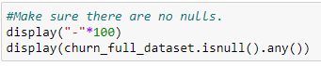
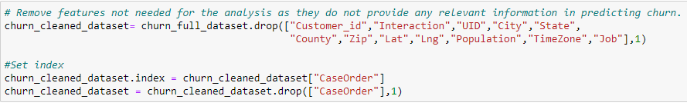
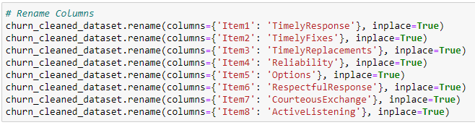
C3. Explain the steps used to prepare the data for the analysis. Identify the code segment for each step.
We loaded, cleaned, and explored the data. Here are the steps.
1. Look for null values and eliminate them. Let the evaluator know if you found any null values in the data.
2. Remove features not required for the analysis.
3. Rename the columns to give proper naming for the predictors.

Slide 92
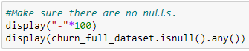
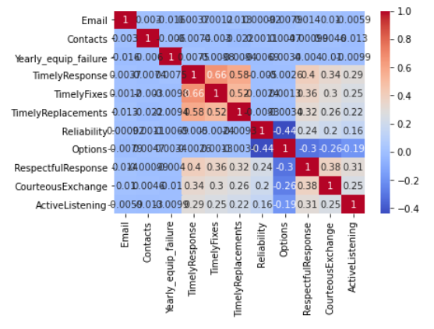
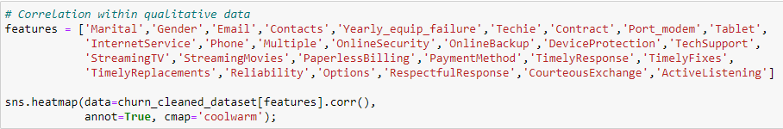
4. Address missing data and outliers- In our data, we did not find any missing data or outliers
5. Look for correlation in data. Correlated features will carry extra weight on the distance calculation than desired that could negatively impact the model. A heatmap can help show that correlation. It is a colorful graph that can visually show frequency or interaction using a range of colors.

Slide 93
Per observation, we see some close correlation between TimelyResponses, TimelyFixes, TimelyReplacements, RespectfulResponse, CourteousExchange, and ActiveListening.
6. Convert categorical variables into dummy variables, and this also takes care of datatype change to int for all the object datatypes variables. Paste your code here.
7. Variable/feature selection is important to understand which features are useful in predicting a target variable. This helps select the correct features and eliminate those that do not help much with the prediction, thus improving a predictive model's efficiency and effectiveness. You can use “SelectKBest” from scikit-learn to identify important features. Paste your code here.
C4. Provide a copy of the cleaned data set.

Slide 94
Part IV: Analysis
D. Perform the data analysis and report on the results by doing the following:
D1. Split the data into training and test data sets and provide the file(s).
You can use the train_test_split library from sklearn.model_selection to split the data into 80% training and 20% testing data sets.
The model is trained on the training data set.
The model is evaluated on the testing data set. This approach is also called hold-out validation.
This is to ensure the model has similar accuracy when predicting unseen data (new data sets that the model has not seen before during the training).

Slide 95
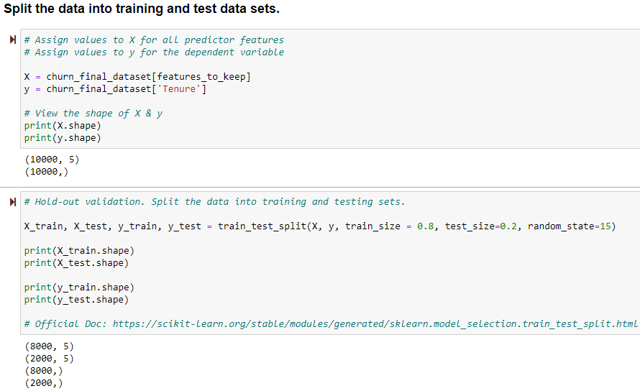
Code to split the data into training and testing sets

Slide 96
R Code to split the data
x_train, x_test, y_train, y_test = sklearn.model_selection.train_test_split(X, yrandom_state=0, train_size=0.8,test_size = 0.2)
Save the split data components into CSV files and they would be loaded into the assessment tool for D209 Task2
x_test.to_csv(r'x_test_file_t2.csv',index=False)
y_test.to_csv(r'y_test_file_t2.csv',index=False)
x_train.to_csv(r'x_train_file_t2.csv',index=False)
y_train.to_csv(r'y_train_file_t2.csv',index=False)

Slide 97
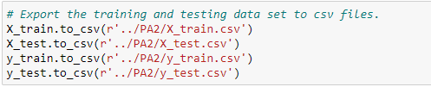
Code to export the training and testing data sets.
The exported files are available as:
Data set | File name
X_train | X_train.csv
X_test | X_test.csv
y_train | y_train.csv
y_test | y_test.csv

Slide 98
D2. Describe the analysis technique you used to appropriately analyze the data. Include screenshots of the intermediate calculations you performed.
Your analysis techniques will be DT, RF, or R(Lasso, Ridge). Describe and explain what it is and how you use it to do your analysis. Provide a detailed interpretation of each result with screenshots. That may cover:
Converting the categorical variables into dummy variables.
Splitting the data into 80% training set and 20% testing set.
Building the model.
Instantiating the DT or RandomForestRegressor object.
Identify optional values for parameters using hyperparameter tuning.
Instantiating the GridSearchCV() object.
Performing GridSearchCV and training the model
Checking and printing best parameters used.
Checking the best score for the top-performing model.
Printing MSE, RMSE, and R-Squared - scores
Performing predictions on the test data and print test accuracy score.
Determining which features were the most predictive according to Decision Tree or Random Forests Regressor.

Slide 99
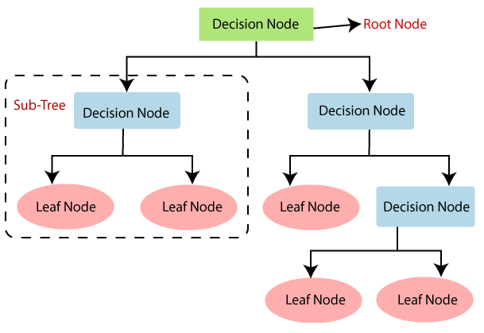
D2. Cont’d
If you used a decision tree, you might want to explain it. DT is a non-parametric supervised learning method that builds the models in a tree structure. It breaks down a data set into smaller and smaller subsets while at the same time an associated decision tree is incrementally developed. The result is a tree with decision nodes and leaf nodes. A decision node has two or more branches. Leaf node represents a classification or decision. The topmost decision node in a tree corresponds to the best predictor called the root node. Decision trees can handle both categorical and numerical data.

Slide 100
For Random Forests: RFs are an ensemble learning method for classification and regression problems. It constructs multiple decision trees at the training time and outputs the mean of the predictions for regression
Each of the trees makes its own individual prediction. These predictions are then averaged to produce a single result
A prediction from the Random Forest Regressor is an average of the trees' predictions in the forest (Medium, 2018; Datacamp, n.d; Neptune, 2021; Scikit-learn, 2020).
You can use the Scikit-learn library of Python to build the random forest model.

Slide 101
You may convert the categorical variables into dummy variables as required for the random forest algorithm to use the data for creating the model. See sample code below:
Splitting the data into 80% training set and 20% testing set. Fit the model on the training data set and evaluate its scores on the testing dataset.
Perform hyperparameter tuning and identify the best values using GridSearchCV() class Hyperparameter tuning tries multiple values for the parameters, fits all of them separately, sees how well they perform, and chooses the best value for each parameter.

Slide 102
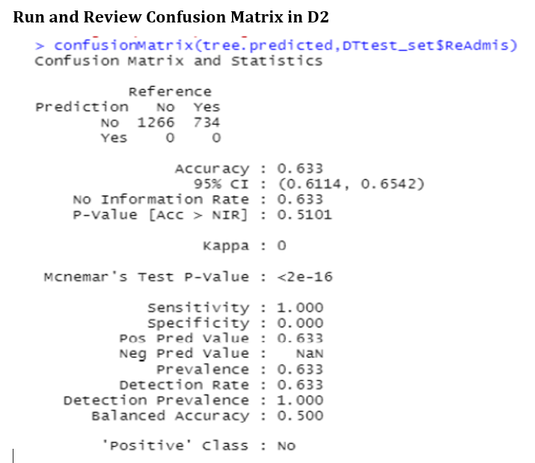

Slide 103
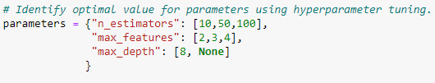
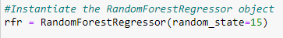
Providing values:
For n_estimators you may provide values say 10, 50, and 100.
For max_features you may provide values say 2,3, and 4.
For max_depth values 8 and None.
None indicates nodes are expanded until all leaves are pure or until all the leaves contain less than min_samples_split samples.
Instantiate the RandomForestRegressor object
MSE: You can use mean squared error (MSE) as a scoring function to evaluate the model e.g.
scorer = make_scorer(MSE)
You can use GridSearchCV, to performs k-folds cross-validations and hyperparameter tuning.

Slide 104
Model Evaluation is an integral part of the model development process that helps to find the best model that represents our data and how well the chosen model will work in the future.
Two Methods in Data Science: Hold-Out and Cross-Validation.
Hold-Out randomly divides the dataset into three subsets:
Training set is used to build predictive models.
Validation set is used to assess the performance of model built in the training phase. It provides a test platform for fine tuning model's parameters and selecting the best-performing model. Not all modeling algorithms need a validation set.
Test set is used to assess the likely future performance of a model. If a model fit to the training set much better than it fits the test set, overfitting is probably the cause.
Cross-Validation – used when data is limited
K-fold cross-validation divides the data into k subsets of equal size.
We build models k times, each time leaving out one of the subsets from training and use it as the test set.
If k equals the sample size, this is called "leave-one-out".

Slide 105
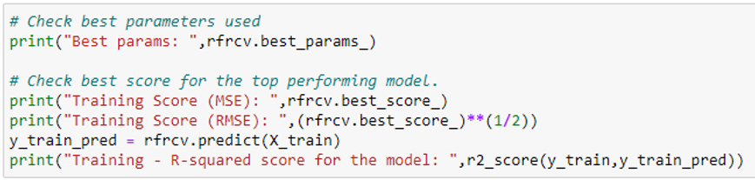
The fit method is then called to run the GridSearchCV object, which trains and evaluates various combinations of models for different parameter values. Example: rfrcv.fit(x-train, y_train)
You can use best_params to view the best model parameters. And best_score provides the best model accuracy score.
The output will show:
The MSE score on the training data set
The root mean squared error (RMSE) score on the training data set.
The r-squared score on the training data set.

Slide 106
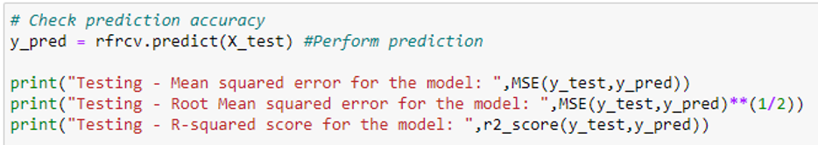
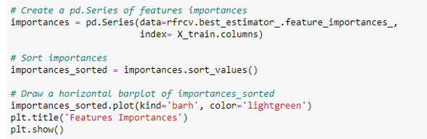
You can perform predictions on the test data and printing test accuracy scores. Check prediction accuracy
Now, you can determine which features were the most predictive according to the random forests regressor. See sample code below:

Slide 107
D3. Provide the code used to perform the prediction analysis from part D2. Copy and paste the codes in your paper for the following: Include others DT RG
Converting the categorical variables into dummy variables if applicable to you.
Splitting the data into 80% training set and 20% testing set.
Creating or building the model.
Plotting and printing DT.
Selecting the classifier and fitting the model.
Instantiate the RandomForestRegressor or DecisionTreeClassifier object.
Identify optional value for parameters using hyperparameter tuning.
Instantiate the GridSearchCV() object
Perform GridSearchCV and train the model
Check and print best parameters used.
Check best score for the top performing model.
Print MSE, RMSE, and R-Squared
Perform predictions on the test data and print test accuracy score.
Determine which features were the most predictive according to Random Forests Regressor.

Slide 108
Part V: Data Summary and Implications
E. Summarize your data analysis by doing the following:
E1. Explain the accuracy and the mean squared error (MSE) of your prediction model.
You can provide as follows:
Mean square error (MSE) score
Root Mean Squared Error (RMSE)
R Squared (R2) - The coefficient of determination
MSE is the difference between the predicted values and the actual values. It determines how good the estimate is based on the algorithm analysis(Grace-Martin, 2020).
The predicted value is based on some equation and tells what you will expect as an average, but the result you get might differ from this prediction which could be a slight error from the estimated value. This difference is called MSE. The lower the value for MSE, the more accurately a model is able to predict values (Zach, 2020, April 16).
Both RMSE and MSE can show if the degree of error is significant in the model.

Slide 109
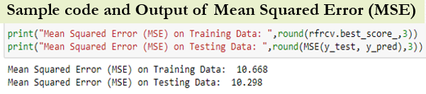
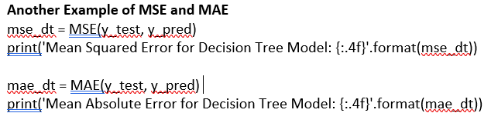
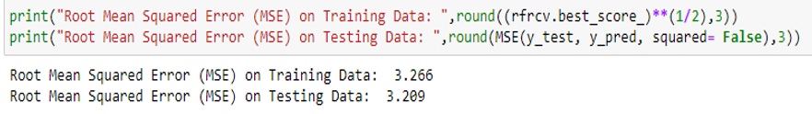
Random forest regressor uses a decision tree regressor. A decision tree regressor uses mean squared error (MSE) to split a node into two or more sub-nodes. This decision of splitting affects a tree's accuracy. The decision tree regressor picks a variable and the value to split on such that the two groups are as different from each other as possible. A weighted average of the groups' mean squared error is then taken (GDCoder, 2020).
Root Mean Squared Error (RMSE) -
This is the square root of the MSE. It is a frequently used measure of the difference between values predicted by a model and the values actually observed. This is defined as the square root of the average squared distance between the actual score and the predicted score (Medium, 2020). Sample code and output of RMSE below:

Slide 110


R Squared (R2) - The coefficient of determination
This metric measures the relationship between the residual sum of squares (RSS) and the total sum of squares (TSS). The RSS is computed as the ground truth minus the predicted ground truth. This metric tells how well a model fits the data. It ranges between 0 and 1. Higher the R-squared, the better the model fits the data.

Slide 111

Sample Code 1 in Python:
# Given table results with the following columns:
results = pd.DataFrame({'Actual y':y_test, 'Predicted y':y_pred}) ## Actual y, Predicted y, error, squared error
results['error'] = results['Actual y'] - results['Predicted y’] ## error = actual y - predicted y
results['squared error'] = np.square(results['error’]) ## squared error = error ** 2
results
results['squared error'].mean()
--------------------------------------------------------------------------------------------------------------------------------
Sample Code 2 in Python:
print(“Best params: “, rfrcv.best_params_) ## check best parameters used
Print(“Training Score (MSE): “,rfrcv.best_score_) ## check best score for the top performing model.
Print((“Training Score (RMSE): “,(rfrcv.best_score_)**(1/2))
y_train-pred = rfrcv.predict(x_train)
print(“Training - R-squared score for the model: “,r2_score(y_train, y_train_pred))

Slide 112

How to Calculate MSE in R
Two methods to calculate the MSE of a regression model in R.
Sample Code 1 in R: Calculating the MSE of a fitted regression model
data(mtcars) ## #load mtcars dataset
model <- lm(mpg~disp+hp, data=mtcars) ## fit regression model
model_summ <-summary(model) ## get model summary
mean(model_summ$residuals^2)
Output (MSE): 8.85917
Sample Code 2 in R: Calculating the MSE from a list of Predicted and Actual Values
R Code
Output
data <- data.frame(pred = predict(model), actual = mtcars$mpg) ##create data frame with a column
of actual and predicted values
head(data) ## view first six lines of data

Slide 113
mean((data$actual - data$pred)^2) ## calculate MSE
Output (MSE) = 8.85917
Predicted probabilities on the test set including RMSE:
predictions_test <- predict(final_model,
demo_test) %>% bind_cols(demo_test)
str(predictions_test)
demo_test <- demo_test %>% mutate(predictions_test)
demo_test$residuals < as.numeric(demo_test$ReAdmis) -
as.numeric(demo_test$.pred_class)
str(demo_test)
rmse_test <- sqrt(mean(demo_test$residuals^2))
rmse_test
#compare the results
rmse and rmse_test
Sample Code Example 1 in R: Calculating the RMSE from a list of Predicted and Actual Values
Predicted probabilities on the training set including RMSE:
predictions <- predict(final_model, demo_train) %>%
bind_cols(demo_train)
str(predictions)
demo_train <- demo_train %>% mutate(predictions)
demo_train$residuals <- as.numeric(demo_train$ReAdmis) -
as.numeric(demo_train$.pred_class)
str(demo_train)
rmse <- sqrt(mean(demo_train$residuals^2))
rmse
https://www.statology.org/author/admin/

Slide 114
E2. Discuss the results and implications of your prediction analysis.
We used Random forest machine learning model for this analysis. The random forest model we developed has a testing r-squared score of 98.5%. This is a good score.
The root mean squared error for this model is 3.209.
We have used the SelectKBest approach of feature selection for this model.
We have used hyperparameter tuning to find the optimal value for n_estimators, max_features, and max_depth. Based on GridSearchCV() the best model provided the optimal value for n_estimators = 10, max_features = 2 and max_depth = None.
The model accuracy could be further improved by performing hyperparameter tuning on additional parameters and by using more labeled data to train the model.

Slide 115
E3. Discuss one limitation of your data analysis.
Random forest is a popular machine learning model, and its ability to predict non-linear data makes it more powerful. However, a random forest cannot extrapolate. It can only make predictions that are an average of previously observed labels. This could be a problem when the training and prediction inputs differ in their range. This is called covariate shift, and it is difficult for most models to handle, especially for Random Forest, because it cannot extrapolate. In such situations, other algorithms could be used like support vector machine (SVM) (Medium, 2018).

Slide 116
E4. Recommend a course of action for the real-world organizational situation from part A1 based on your results and implications discussed in part E2.
• Based on this analysis report and the model's accuracy score, the company can use this random forest model to predict the customers' tenure.
• The model could be further improved by performing hyperparameter tuning on additional parameters and by using more labeled data to train the model.
• Based on the exploratory data analysis, customers with higher Bandwidth_GB_Year have a higher tenure. Further analysis should be done on customers with less Bandwidth_GB_Year to see how their usage could be increased and further increase the customer's tenure.
• Customers having OnlineBackup have shorter tenure compared to customers not having OnlineBackup. The company should investigate this as there is a possibility that customers are not happy with this feature.

Slide 117
Part VI: Demonstration
F. Provide a Panopto video recording that includes a demonstration of the functionality of the code used for the analysis and a summary of the programming environment.
Note: The audiovisual recording should feature you visibly presenting the material (i.e., not in voiceover or embedded video) and should simultaneously capture both you and your multimedia presentation.
See Requirement page for details on how to access, use, and submit your Panopto video recording.
G. Record the web sources used to acquire data or segments of third-party code to support the analysis. Ensure the web sources are reliable.
H. Acknowledge sources, using in-text citations and references, for content that is quoted, paraphrased, or summarized.
If the evaluation commented that the reference list citations are presented with limited bibliographical detail. See what it means on the next slide.

Slide 118
The lack of bibliographical details means that the reference (s) even though listed did not have the minimal set of elements needed to identify that source. For a Journal article, you might need: name of the author(s), year of publication, title, journal name, volume, issue number, pagination, URL, etc.
Journal Example:
Debbie, T., Timothy, K. J., & Mark, F. N. (2007). IT project risks: The project management professional perspective. The Journal of Computer Information Systems, 1-5.
Web Example:
Brownlee, J. (2018). Metrics to evaluate machine learning algorithms in Python. Retrieved 01/03/2022 from https://machinelearningmastery.com/metrics-evaluate-machine-learning-algorithms-python
I. Demonstrate professional communication in the content and presentation of your submission.

Slide 119
FAQ
Q1. What is the difference between correlation and regression:
The difference is that while correlation measures the strength of an association between two variables, regression quantifies the nature of the relationship.
from sklearn.ensemble import RandomForestRegressor
# Instantiae Random Random Forest Regressor model
rfr = RandomForestRegressor(n_estimators=500, random_state=1)
# Fit model to dataframe
rfr.fit(X_train, y_train)
If you choose to work with the classifier, check this link out:
https://www.datacamp.com/community/tutorials/random-forests-classifier-python
If you choose to fix the array, this link might be helpful.
https://stackoverflow.com/questions/45554008/error-in-python-script-expected-2d-array-got-1d-array-instead

Slide 120
Q2. Why requiring accuracy and MSE in predictive model?
Accuracy, with a capital A, is a metric used to evaluate classification models, but to measure a predictive model's accuracy, with a lower case ‘a’, is done with MSE, RMSE and R-squared. The smaller the error, the better the accuracy of prediction.
Elaboration on ‘accuracy’ which is what E1 requires.
Using continuous or categorical variable in an analysis does not determine the need for model validation. Most models created needed validation for accuracy and precision. That’s just to know if the model is performing well. In supervised learning you must split the dataset into training and test sets. The test set is to be used to validate the model performance (accuracy and precision). Regression, ARIMA, Neural Networks, etc., are all predictive models and they are validated for accuracy and precision.
The difference is that the metrics and approach for testing model accuracy in classification is not the same as in predictive models. For example, if you are working on a classification problem, the best score is 100% accuracy. If you are working on a regression problem, the best score is 0.0 error.

Slide 121
In Task 2, the MSE, RMSE, and R-Squared are evaluation metrics for testing model accuracy. After splitting the data, you can check the best score for the top performing model, you can check for training accuracy and print the score. After performing predictions, you can check for prediction accuracy. If the model accuracy needs improvement, you can perform hyperparameter tuning on additional parameters or use more labeled data to train the model.
Q3. Explain MSE, MAE, RMSE, R-Squared.
Mean squared error (MSE): is the difference between the estimated values and the actual values. The predicted value is based on some equation and tells what you will expect as an average, but the result you get might differ from this prediction which might be a slight error from the estimated value. This difference is called MSE.
A decision tree regressor uses mean squared error (MSE) to split a node into two or more sub-nodes. The decision tree regressor picks a variable and the value to split on such that the two groups are as different from each other as possible. A weighted average of the groups' mean squared error is then taken (GDCoder, 2020).

Slide 122
Root Mean Squared Error (RMSE): This is the square root of the MSE. It is a frequently used measure of the difference between values predicted by a model and the values actually observed. This is defined as the square root of the average squared distance between the actual score and the predicted score (Medium, 2020).
R Squared (R2) - The coefficient of determination measures the relationship between the residual sum of squares (RSS) and the total sum of squares (TSS). The RSS is computed as the ground truth minus the predicted ground truth. This metric tells how well a model fits the data. It ranges between 0 and 1. Higher the R-squared, the better the model fits the data.
Mean absolute error (MAE) is a measure of errors between paired observations expressing the same phenomenon. It measures the average magnitude of the errors in a set of forecasts, without considering their direction. It measures accuracy for continuous variables.

Slide 123
Q4. If your MSE output was “NA”
If your MSE output was “NA” it was an indication that your model is not reliable since it could not be calculated. It may be due to the way set up your model and the types of variables used. You may need to convert your categorical variables to numeric. Your output must be a continuous variable.
To calculate MSE, First import the library/package: sklearn.metrics import mean_squared_error as MSE.
Quick Video on how to calculate MSE in Python:
https://www.youtube.com/watch?v=tJpzKILW-Kg
Calculating Mean Squared Error in Python:
https://www.educative.io/answers/calculating-mean-squared-error-in-python

Slide 124
Q2. What are the classification metrics to evaluate Machine Learning Algorithms in Python?
Classification Metrics to evaluate Machine Learning Algorithms in Python are:
Classification Accuracy.
Log Loss.
Area Under ROC Curve.
Confusion Matrix.
Classification Report.
Q3. What is AUC, ROC, Accuracy Score?
AUC and ROC are performance metric for binary classification problems.
The AUC represents a model’s ability to discriminate between positive and negative classes. An area of 1.0 represents a model that made all predictions perfectly. An area of 0.5 represents a model as good as random.
A ROC Curve is a plot of the true positive rate and the false positive rate for a given set of probability predictions at different thresholds used to map the probabilities to class labels. The area under the curve is then the approximate integral under the ROC Curve.
Brownlee, J. (2018). Metrics to evaluate machine learning algorithms in Python. Retrieved 10/20/2021 from
https://machinelearningmastery.com/metrics-evaluate-machine-learning-algorithms-python
Brownlee, J. (2018). How to Use ROC Curves and Precision-Recall Curves for Classification in Python. Retrieved from
https://machinelearningmastery.com/roc-curves-and-precision-recall-curves-for- classification-in-python/

Slide 125
Accuracy score - Is correct classifications over total samples.
Precision score – Percentage of correct classifications per label. The number of true positives divided by the number of true and false positives.
Recall score –The number of true positives divided by the number of true positives plus the number of false negatives.
F1_score - Average of Precision and Recall scores.
Q4. What is a baseline predictive model?
A baseline is a simple and well understood procedure for making predictions on your predictive modeling problem. The results for the baseline model provide the point from which the skill of all other models trained on your data can be evaluated.
Three examples of baseline models include:
Predict the mean outcome value for a regression problem.
Predict the mode outcome value for a classification problem.
Predict the input as the output (called persistence) for a univariate time series forecasting problem.

Slide 126
Huber loss is both MSE and MAE. It is quadratic(MSE) when the error is small else MAE.
CODES:
# Check best parameters used
print("Best params: ",rfrcv.best_params_)
# Check best score for the top performing model.
print("Training Score (MSE): ",rfrcv.best_score_)
print("Training Score (RMSE): ",(rfrcv.best_score_)**(1/2))
y_train_pred = rfrcv.predict(X_train)
print("Training - R-squared score for the model: ",r2_score(y_train,y_train_pred))
Here is the output approximated:
Best params: {'max_depth': None, 'max_features': 2, 'n_estimators': 10}
Training Score (MSE): 10.7
Training Score (RMSE): 3.3
Training - R-squared: 0.99
# Check prediction accuracy
y_pred = rfrcv.predict(X_test) #Perform prediction
print("Testing - Mean squared error for the model: ",MSE(y_test,y_pred))
print("Testing - Root Mean squared error for the model: ",MSE(y_test,y_pred)**(1/2))
print("Testing - R-squared score for the model: ",r2_score(y_test,y_pred))
Here is the output approximated:
Testing - Mean squared error for the model: 10.3.
Testing - Root Mean squared error for the model: 3.2.
Testing - R-squared score for the model: 0. 98.

Slide 127
Q. Is it required to do hyperparameter twice or more?
Hyperparameter helps you identify the optimal value for parameters. It also helps improve model accuracy further if performed on additional parameters. It is not required to do more than once, but you could do more than once if the first one did not give you the desired result or you need to improve your model performance even further.
Analytics Vidhya (April 2021). Evaluating Machine Learning Models using Hyperparameter Tuning.
https://www.analyticsvidhya.com/blog/2021/04/evaluating-machine-learning-models-hyperparameter-tuning/

Slide 128
REFRENCE SECTION
TASK 2

Slide 129
Python - Decision Tree Analysis
Datacamp. (n.d). Decision-Tree for Classification. https://campus.datacamp.com/courses/machine-learning-with-tree-based-models-in-python
GDCoder. (2020, Feb 5). Decision tree regressor explained in depth. https://gdcoder.com/decision-tree-regressor-explained-in-depth/
Medium. (2018, Sep 26). Decision trees explained. https://towardsdatascience.com/decision-trees-explained-3ec41632ceb6
Medium. (2020, Jun 18). What is one-hot encoding and how to use pandas get_dummies function. https://towardsdatascience.com/what-is-one-hot-encoding-and-how-to-use-pandas-get-dummies-function-922eb9bd4970.
Navlani, A. (2018, December 28). Attention Required! | Cloudflare. Datacamp. https://www.datacamp.com/community/tutorials/decision-tree-classification-python
Sehra, C. (2020, November 30). Decision Trees Explained Easily - Chirag Sehra. Medium. https://chiragsehra42.medium.com/decision-trees-explained-easily-28f23241248

Slide 130
Python - Decision Tree Analysis Cont’d
K, D. (2021, April 10). Implementing Regression Using a Decision Tree and Scikit-Learn. Medium. https://heartbeat.fritz.ai/implementing-regression-using-a-decision-tree-and-scikit-learn-ac98552b43d7

Slide 131
Python – Random Forests
Datacamp. (n.d). Visualizing features importances. https://campus.datacamp.com/courses/machine-learning-with-tree-based-models-in-python/bagging-and-random-forests?ex=10
Medium. (2020, Aug 4). How to evaluate the performance of a machine learning model. https://towardsdatascience.com/how-to-evaluate-machine-learning-model-performance-in-python-135b4ae27f7e
Neptune. (2021, Feb 25). Random Forest Regression: When Does It Fail and Why?. https://neptune.ai/blog/random-forest-regression-when-does-it-fail-and-why
Scikit-learn. (2020). Random forest regressor. https://scikit-learn.org/stable/modules/generated/sklearn.ensemble.RandomForestRegressor.html
StackExchange. (n.d). Random forest assumptions. https://stats.stackexchange.com/questions/59124/random-forest-assumptions
WGU. (n.d). Data files and associated dictionary files. https://access.wgu.edu/ASP3/aap/content/g9rke9s0rlc9ejd92md0.html

Slide 132
Python - Advanced Regression (lasso or ridge)
Grace-Martin, K. (2020, November 2). Assessing the Fit of Regression Models. The Analysis Factor. https://www.theanalysisfactor.com/assessing-the-fit-of-regression-models/
https://scikit-learn.org/stable/modules/generated/sklearn.metrics.roc_auc_score.html
Class and function reference of scikit-learn.
https://scikit-learn.org/stable/modules/classes.html#module-sklearn.metrics

Slide 133
R - Decision Tree Analysis
Grace-Martin, K. (2020, November 2). Assessing the Fit of Regression Models. The Analysis Factor. https://www.theanalysisfactor.com/assessing-the-fit-of-regression-models/
Data Science Show. (2017). Decision Tree Analysis in R Example Tutorial. Decision Tree Analysis in R Example Tutorial
K, D. (2021, April 10). Implementing Regression Using a Decision Tree and Scikit-Learn. Medium. https://heartbeat.fritz.ai/implementing-regression-using-a-decision-tree-and-scikit-learn-ac98552b43d7
Johnson, D. (2022). Decision Tree in R: Classification Tree & Code in R with Example. https://www.guru99.com/r-decision-trees.html Ketha, R. (2020). How to Split Data into Training and Testing Sets in R Studio. https://youtu.be/pDgTMl0Ed0Q
Navlani, A. (2018, December 28). Attention Required! | Cloudflare. Datacamp. https://www.datacamp.com/community/tutorials/decision-tree-classification-python
Sehra, C. (2020, November 30). Decision Trees Explained Easily - Chirag Sehra. Medium. https://chiragsehra42.medium.com/decision-trees-explained-easily-28f23241248

Slide 134
R – Random Forests
https://www.simplilearn.com/tutorials/data-science-tutorial/random-forest-in-r
https://www.analyticsvidhya.com/blog/2021/06/understanding-random-forest
StatQuest: Random Forests Part 1 - Building, Using and Evaluating – YouTube
https://www.r-bloggers.com/2017/07/random-forests-in-r/
https://www.section.io/engineering-education/introduction-to-random-forest-in-machinelearning/#:~:text=The%20(random%20forest)%20algorithm%20establishes,the%20precision %20of%20the%20outcome.
https://www.edureka.co/blog/random-forest-classifier/

Slide 135
R- Advanced Regression (lasso or ridge)
Linear Models. (2021). Scikit-Learn. https://scikitlearn.org/stable/modules/linear_model.html#lasso
Frost, J. (2021, November 14). Mean Squared Error (MSE). Statistics By Jim. https://statisticsbyjim.com/regression/mean-squared-error-mse/
Z. (2021, May 10). How to Interpret Root Mean Square Error (RMSE). Statology. https://www.statology.org/how-to-interpret-rmse/
Landup, D. (2021, May 14). Rotate Tick Labels in Matplotlib. Stack Abuse. https://stackabuse.com/rotate-axis-labels-in-matplotlib/ 1.7

